Slide 1
Undifferentiated and dedifferentiated ovarian carcinomas and the SWI/SNF complex
Marisa R. Nucci, MD
Brigham and Women’s Hospital, Boston, MA

Slide 2
Declaração de Conflito de Interesse
Dr. Nucci afirma ter / não ter conflito
de interesse a declarar
Em caso afirmativo, especificar: associação financeira relevante
nos últimos 12 meses e que esteja relacionada ao conteúdo da
atividade científica
Exigência da RDC Nº 96/08 da ANVISA

Slide 3
Disclosure of Relevant Financial Relationships
Dr. Nucci declares he/she has no
conflict(s) of interest to disclose
Specify if affirmative: any relevant financial relationship WITH COMMERCIAL INTERESTS
within the past 12 months, which relates to the content of this educational activity and creates a conflict of interest
RDC Nº 96/08 da ANVISA

Slide 4
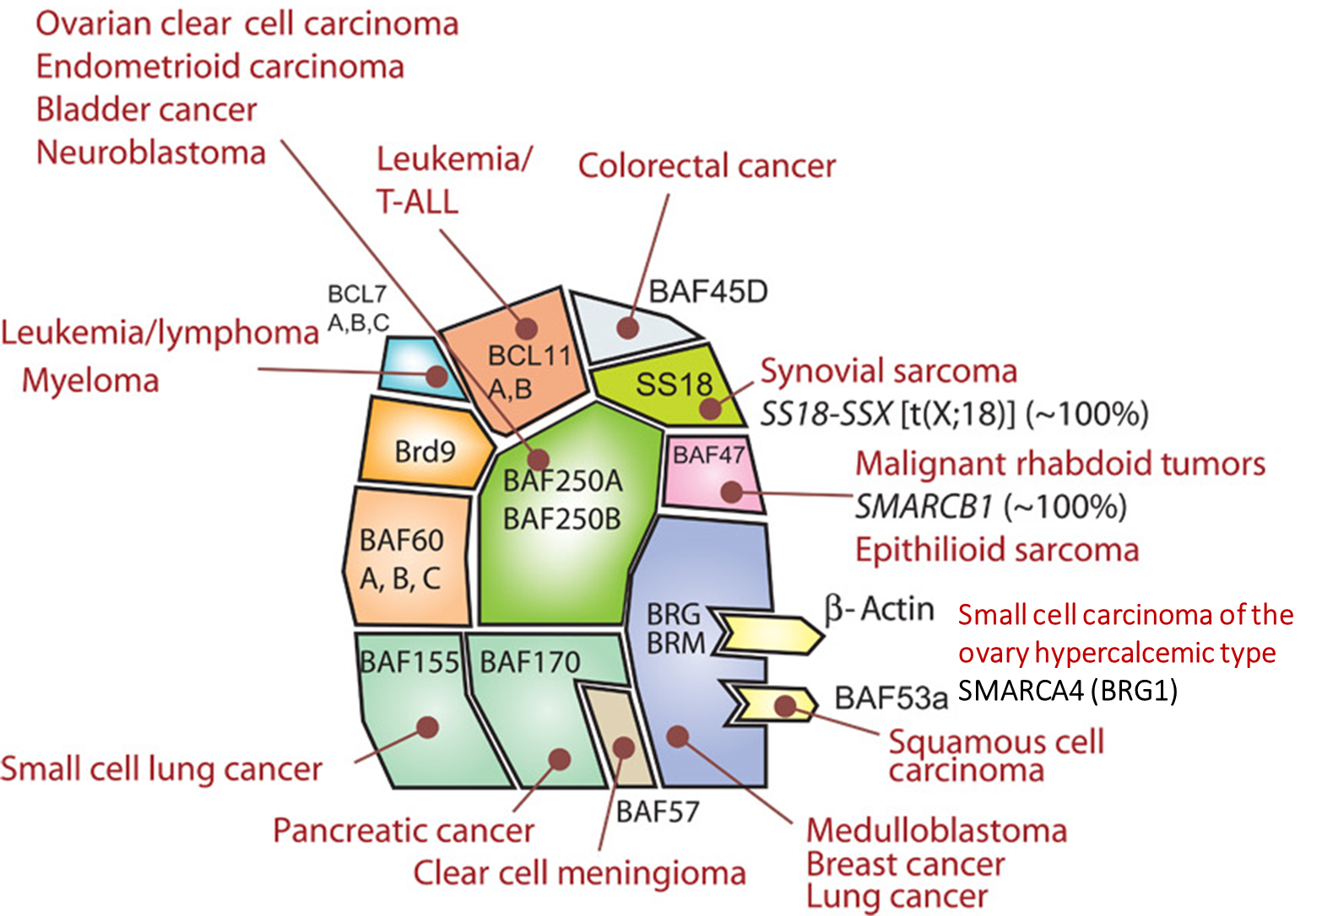
Outline
SWI/SNF complex
SWI/SNF-deficient GYN tumors
Targeted therapies
Notes:
Brief intro in complex and role in cancer

Slide 5
SWI/SNF Complex
Switch sucrose non‐fermentable (SWI/SNF) ATP-dependent chromatin remodeling complex
Regulate transcription by controlling chromatin accessibility by removing polycomb repressive complexes (PRC)
Controls cell proliferation and differentiation
Dysregulation of SWI/SNF leads to unregulated proliferation and prevents cell differentiation
Kadoch C, Crabtree GR. Sci Adv. 2015;1(5):e1500447.
Notes:
Switch snf stands for “switch sucrose non-fermentable” – name dates back to 1980’s when it was discovered in relation to sucrose fermentation yeast
It is an ATP dependent chromatin remodeling complex and it regulated transcription by…
In healthy cells, where the SWI/SNF is intact it controls…
In cancer when it has been inactivated or dysregulated it leads to ….

Slide 6
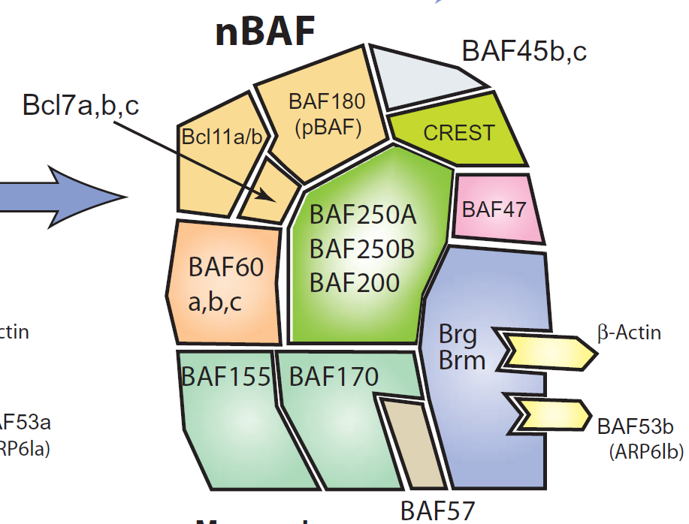
SWI/SNF Complex Components Associated in Various Combinations
SMARCB1
SMARCD
SMARCA2/4
Mutually exclusive
ATP-catylase subunits
ARID1A/B
SMARCC1
Kadoch C, Crabtree GR. Sci Adv. 2015;1(5):e1500447.
Notes:
There are several different components of the SWI/SNF complex that can be associated together in various combinations.
Most of the complexes have around 15 subunits including the core subunits SMARCB1, SMARC1 and SMARCD as well as the mutually exclusive ATP catylase subunits SMARCA2 and SMARCA4 which are linked to the core subunits via ARID1A and ARID1B

Slide 7
Nomenclature...
Gene name | Alternate gene/protein names
SMARCA4 | BRG1, BAF190
SMARCA2 | BRM
SMARCB1 | INI1, hSNF5, BAF47
ARID1A | BAF250A
ARID1B | BAF250B
Notes:
A few words about nomenclature which can be confusing mostly because they were discovered in yeast and studied in drosophila and finally in humans and they have carried a variety of different names.
For simplicity I will be referring to the accepted gene names on the left. You may be most familiar with INI1, which I will refer to as SMARCB1

Slide 8
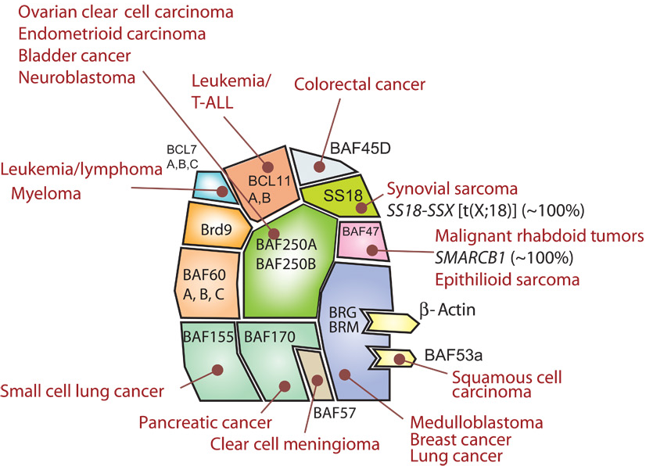
ARID1A/B
*
SMARCD
Small cell carcinoma of the ovary hypercalcemic type
SMARCA4 (BRG1)
SMARCC1
Kadoch C, Crabtree GR. Sci Adv. 2015;1(5):e1500447.
SMARCE1
Notes:
The SWI/SNF complex was originally implicated in cancers when it was discovered in malignant rhabdoid tumors, which are characterized by biallelic inactivation of SMARCB1.
Since then, it has been discovered in many different and diverse tumors including melanoma, lymphoma and sarcoma. Some of the subtypes seem to be associated with different cancers suggesting that there is tissue specific protective roles for these components

Slide 9
SWI/SNF Complex in Cancer Biology
SWI/SNF mutations in ~20% of human malignancies
Somatic or germline
Point mutation/deletion/translocation
Early/initiating vs late/secondary
Associated with aggressive disease course and poor response to chemotherapy
Huge need for improved systemic therapies
Kadoch C, Crabtree GR. Sci Adv. 2015;1(5):e1500447.
Notes:
SWI/SNF complex is mutated in ~20% of cancers.
These mutations can be either somatic or germline and they can be inactivated in a variety of ways including point mutations, deletions or translocations
They can be early disease defining events such as in malignant rhabdoid tumor or they can be late/secondary events associated with dedifferentiation
Invariably they are associated with an aggressive…and there really is a need for novel therapeutics for these cancers

Slide 10
Outline
SWI/SNF complex
SWI/SNF-deficient GYN tumors
Targeted therapies
Notes:
Moving on to SWI/SNF deficient tumors of the GYN tract

Slide 11
SWI/SNF tumors of the gynecologic tract
Small cell carcinoma of the ovary, hypercalcemic type (SMARCA4)
De/undifferentiated ovarian carcinoma (SMARCA4/B1, ARID1A/B)
Clear cell/endometrioid carcinoma (ARID1A)
Anaplastic ca in mucinous tumors (SMARCA4, ARID1A, SMARCB1)
De/undifferentiated endometrial carcinoma (SMARCA4/B1, ARID1A/B)
Clear cell/endometrioid carcinoma (ARID1A)
SMARCA4-deficient uterine sarcoma
Proximal-type epithelioid sarcoma (SMARCB1)
Myoepithelial carcinoma (SMARCB1)
Myoepithelioma-like tumor of the vulvar region (SMARCB1)
Vulvar yolk sac tumors (SMARCB1)
Notes:
These can be considered in a number of different ways. Easiest or most obvious is to group by organ – ovary, endometrium and vulva - and for the purposes of this talk we will be focusing on those that occur in the ovary.

Slide 12
SWI/SNF mutations may be early or late events
 | Early event | Late event
Ovary | Small cell carcinoma of the ovary, hypercalcemic type (SCCOHT) Clear cell/endometrioid carcinoma | De(un)differentiated ovarian carcinoma Mural nodules in mucinous tumors
Endometrium/uterus | Clear cell/endometrioid carcinoma SMARCA4-deficient uterine sarcoma (SDUS) | De(un)differentiated endometrial carcinoma
Vulva | Epithelioid sarcoma Myoepithelial carcinoma Myoepithelioma-like tumors of the vulvar region (MELTVR) Vulvar yolk sac tumor
Notes:
Alternatively the other way to think about them is whether or not the mutation is disease defining early event, such as in the case of SCCOHT or whether they are late events associated with dedifferentiation

Slide 13
Notes:
We’ll start our discussion with SCCOHT. This is the oldest and most well studied SWI/SNF tumor of the GYN tract being originally reported by Dr. Scully in 1982 and the AJSP study from 1994 remains the largest study of these tumors to date

Slide 14
Small cell carcinoma of the ovary, hypercalcemic type (SCCOHT)
Average age 24 (range 9-43)
2/3 have hypercalcemia
Large, unilateral ovarian masses (mean 15 cm)
Pelvic pain, swelling
Rare, aggressive malignancy
  Historically, overall survival 10-20%
Stage most important prognostic factor
Young RH, Oliva E, Scully RE. Am. J. Surg. Pathol. 1994;18:1102–16.
Notes:
Affects young women and 2/3 have hypercalcemia and it was really the triad of small cell morphology, young patient age and hypercalcemia helped define this as an entity
Very aggressive tumor – in older series in the literature/historically overall survival dismal although this has improved with modern chemotherapy

Slide 15
Small Cell Carcinoma of Ovary Hypercalcemic Type
Overall survival: 10%
Stage I: 33%
Favorable prognostic factors:
Age > 30 years
Normal pre-operative calcium levels
Size < 10 cm
No large cell component

Slide 16
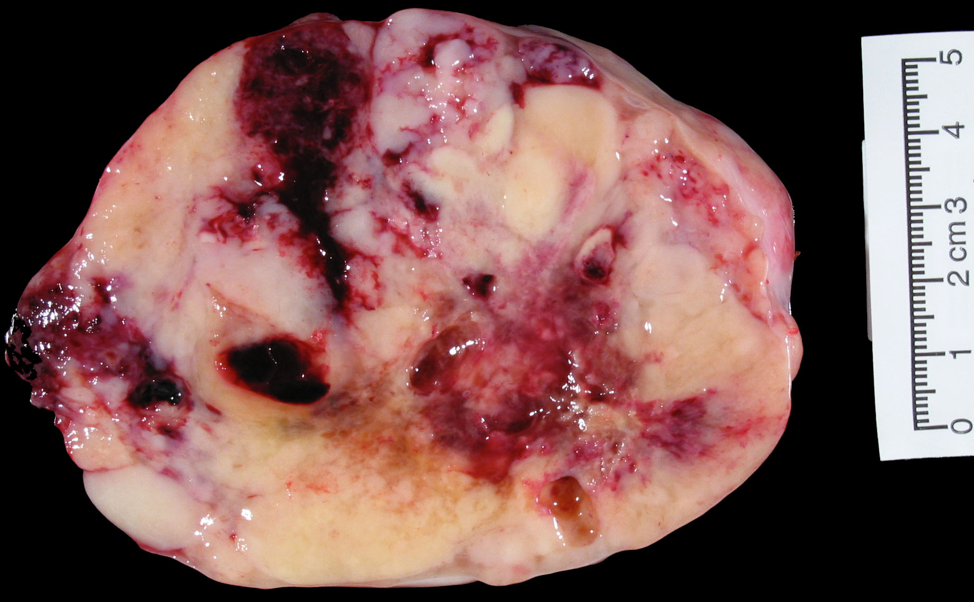
Small cell carcinoma of the ovary, hypercalcemic type
Lobulated surface
Grey/tan/cream color
Fleshy cut surface
Notes:
Grossly the tumors are usually >10 cm, have a lobulated or nodular external surface, are soft tan gray or cream colored (sometimes yellow) masses with fleshy cut surface; often with hemorrhage and necrosis

Slide 17
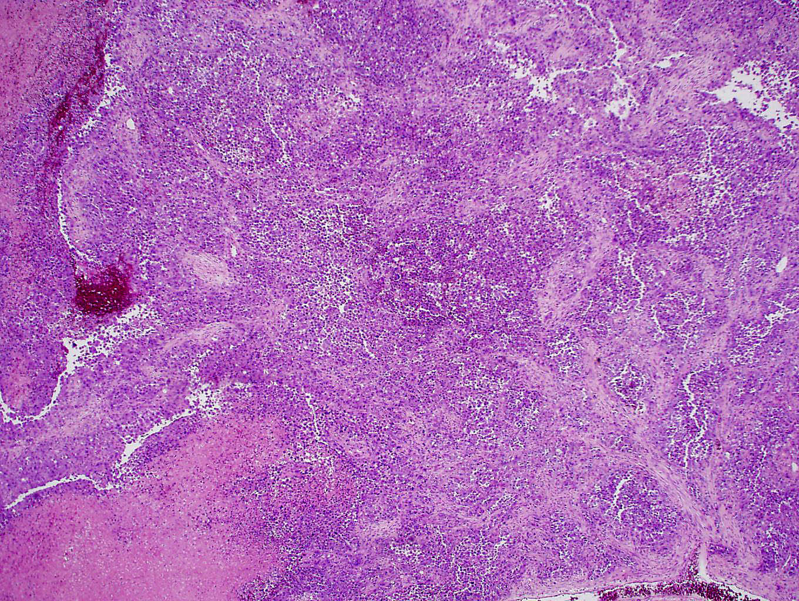
Growth
Patterns
Diffuse > trabecular, nested, corded, single file

Slide 18
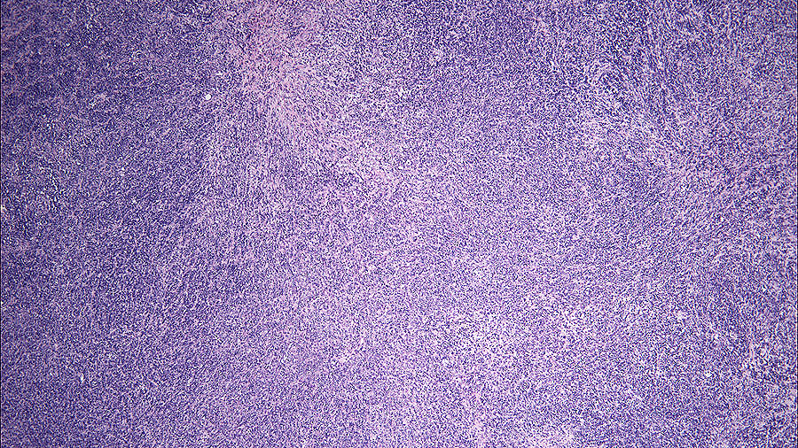
Diffuse

Slide 19
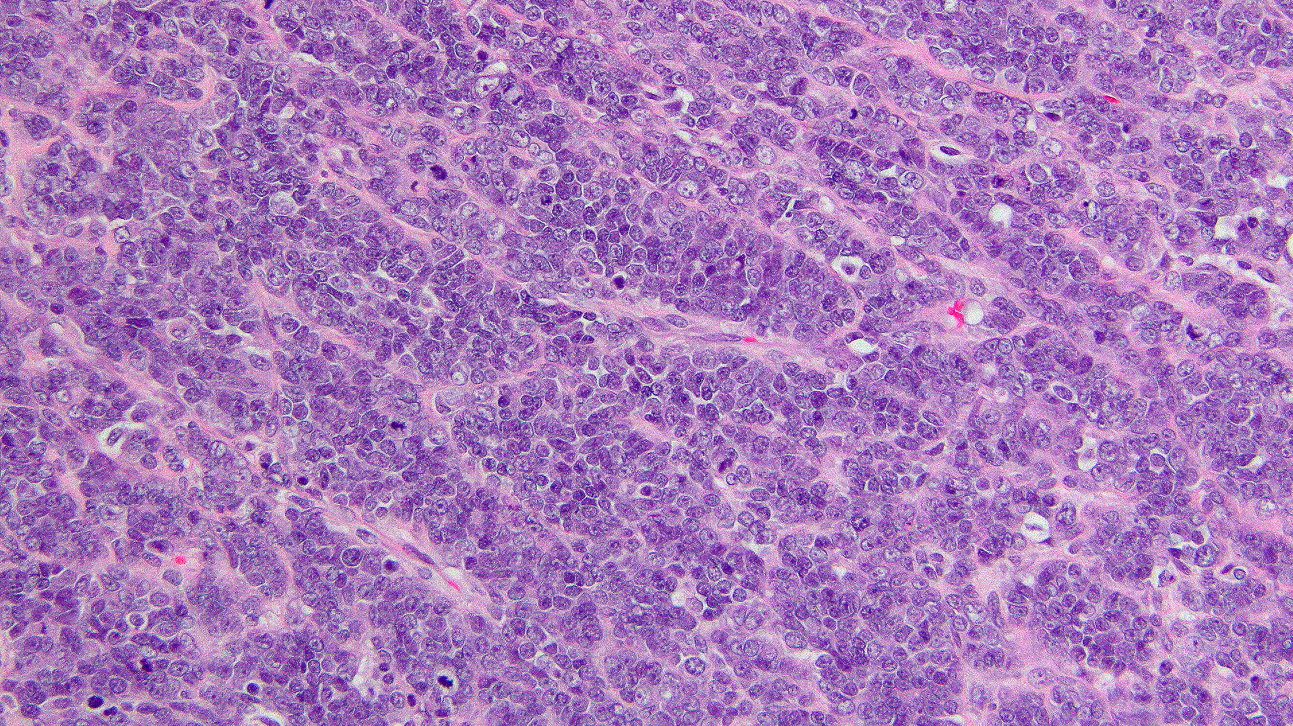
Trabecular

Slide 20
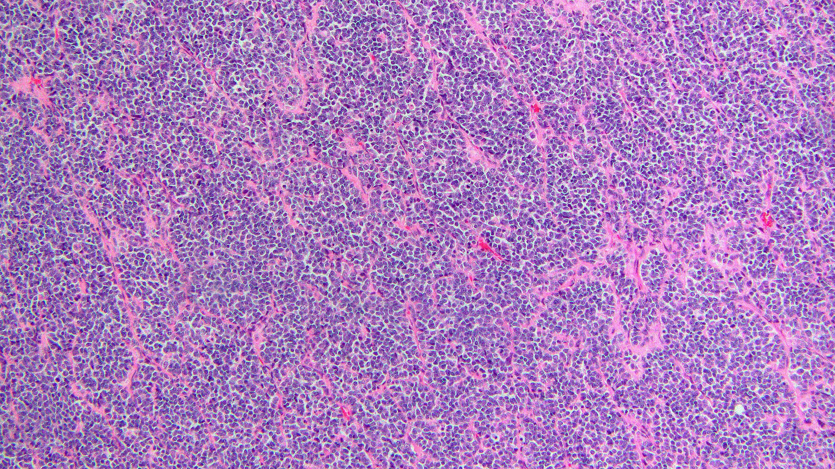
Nested
Notes:
vague

Slide 21
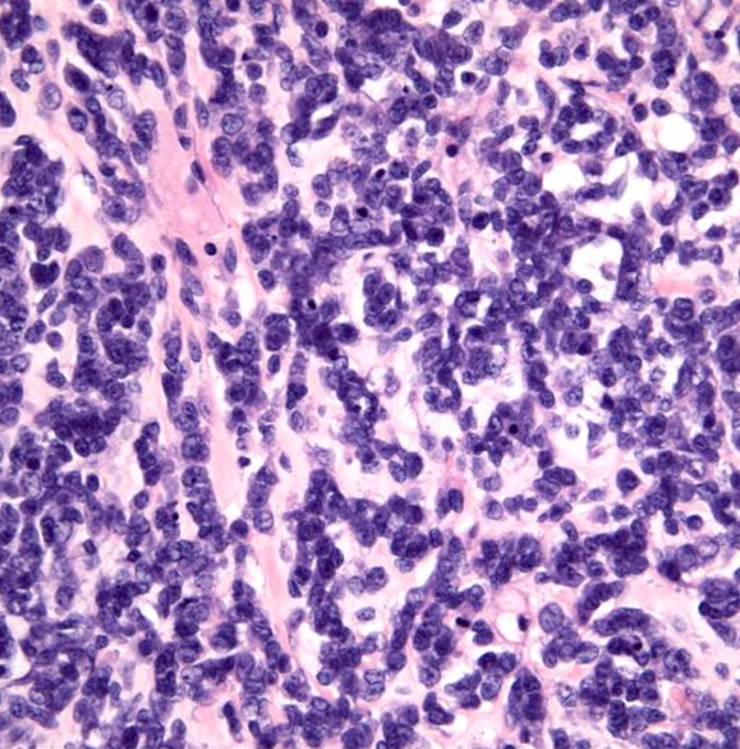
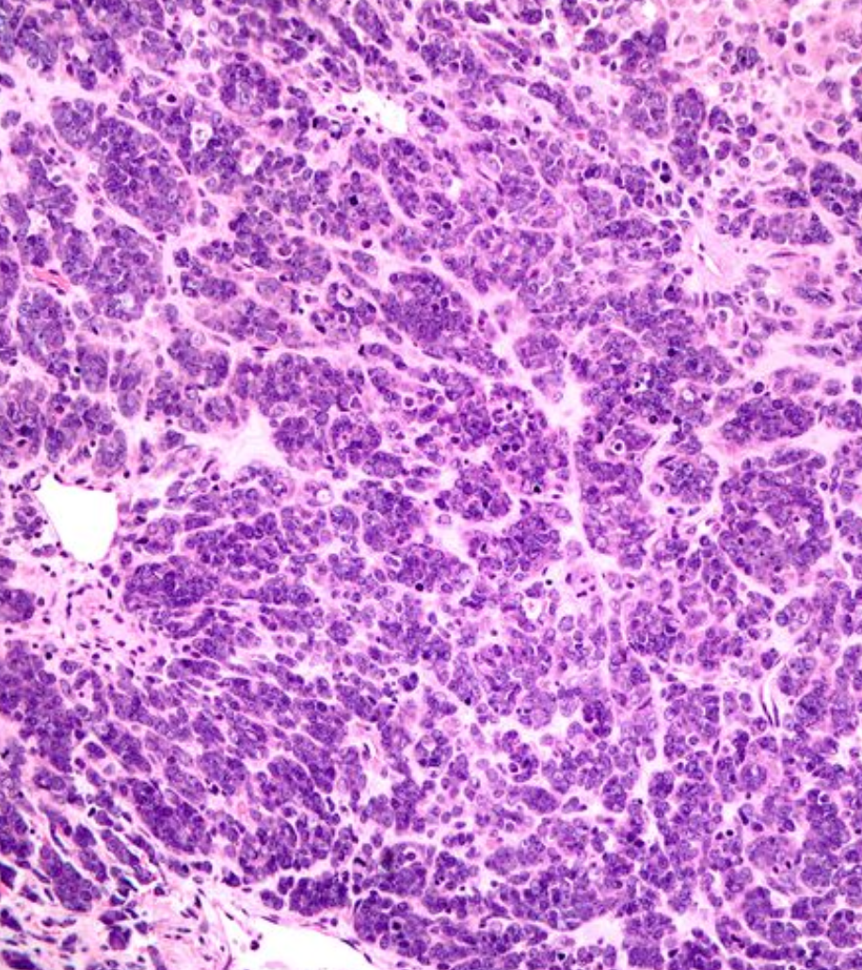

Slide 22
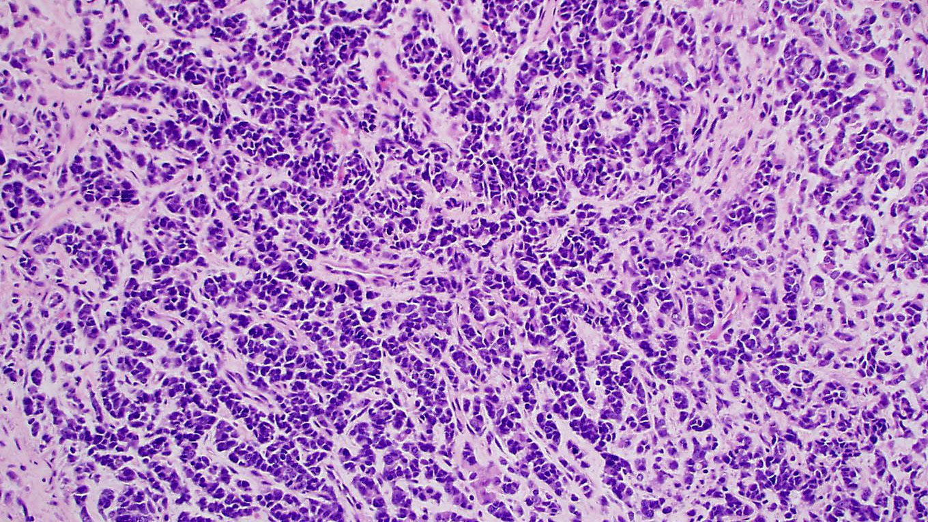
Corded

Slide 23
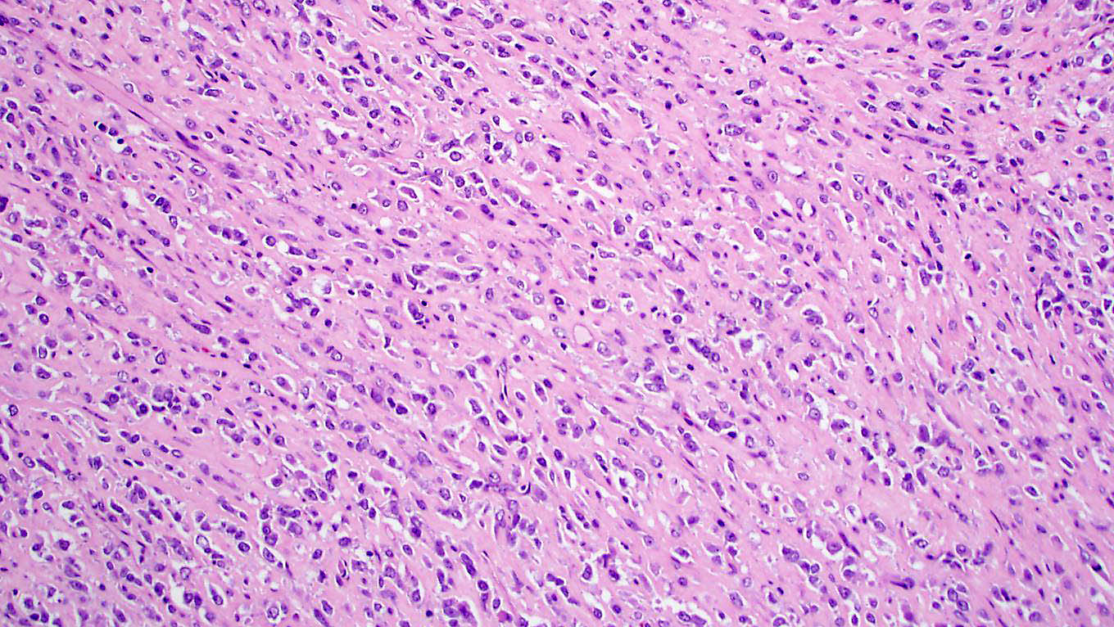
Single file

Slide 24
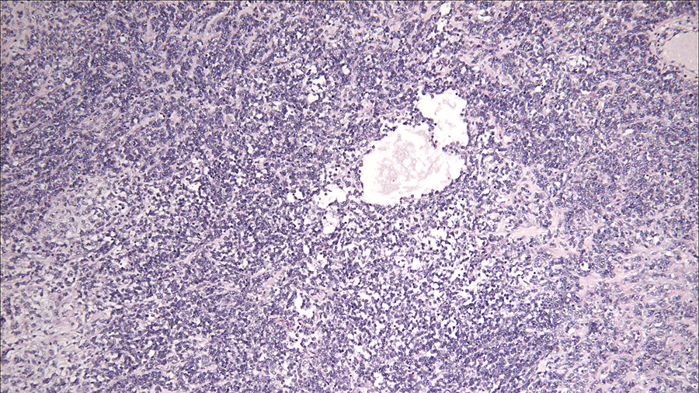
Notes:
Follicle like spaces vary in size and shape; usually not numerous within a tumor although 80% show these structures

Slide 25
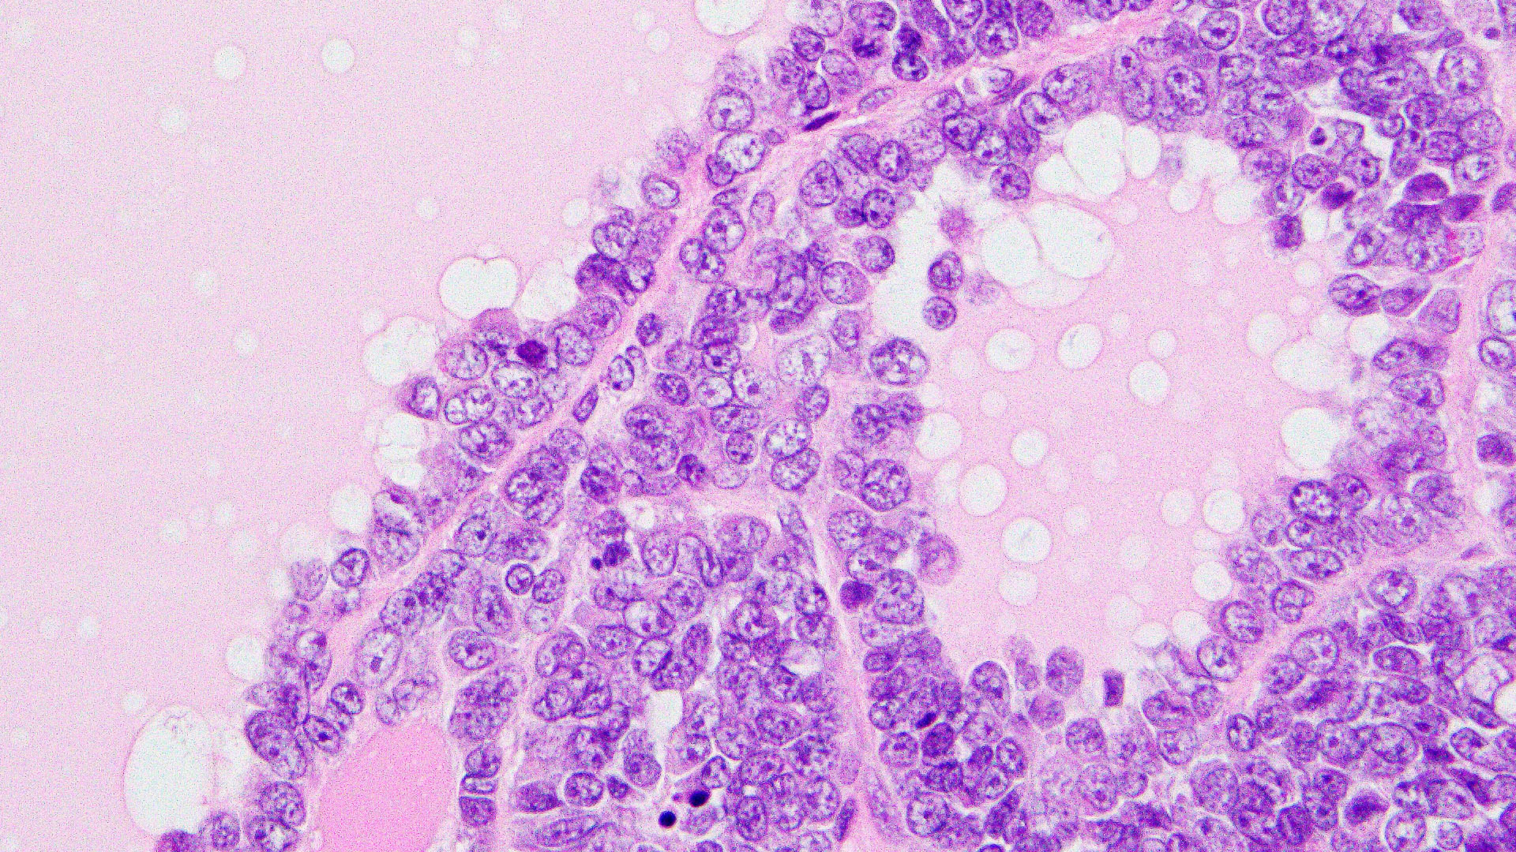
Notes:
Follicle like spaces are usually lined by cells that show no polarity. The spaces may contain eosinophilic or basophilic fluid

Slide 26
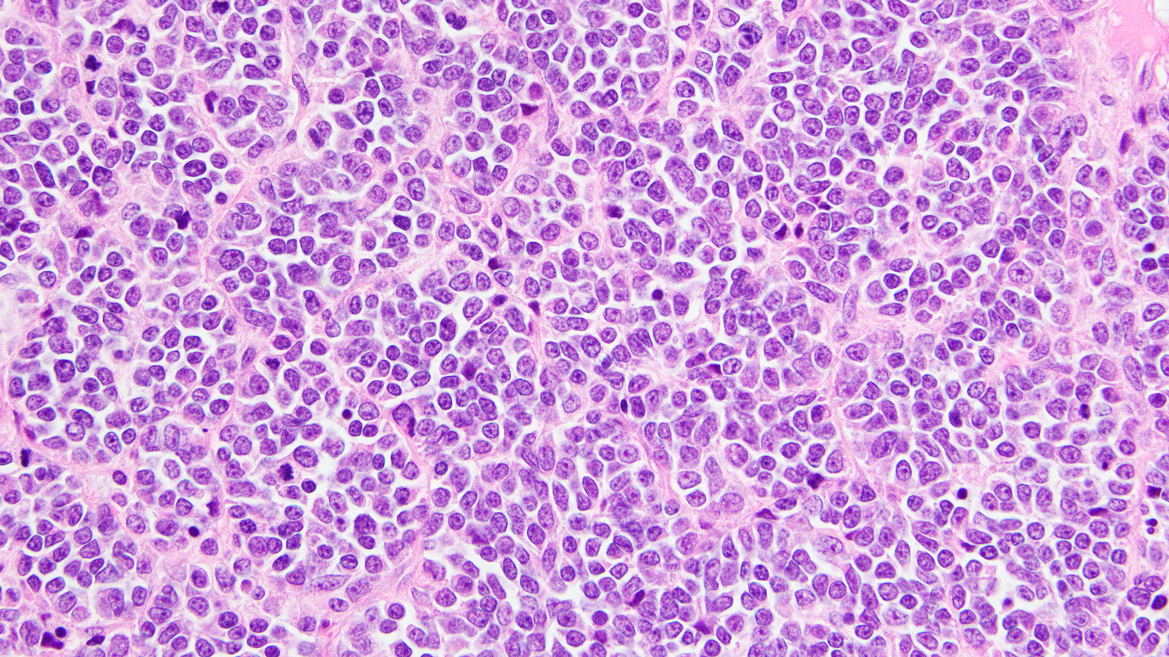
Notes:
Cytology- small cells with scant cytoplasm, hyperchromatic nuclei and small nucleoli

Slide 27
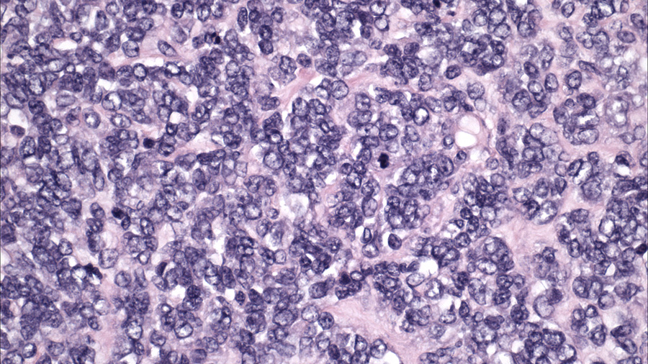
Notes:
Brisk mitoses

Slide 28
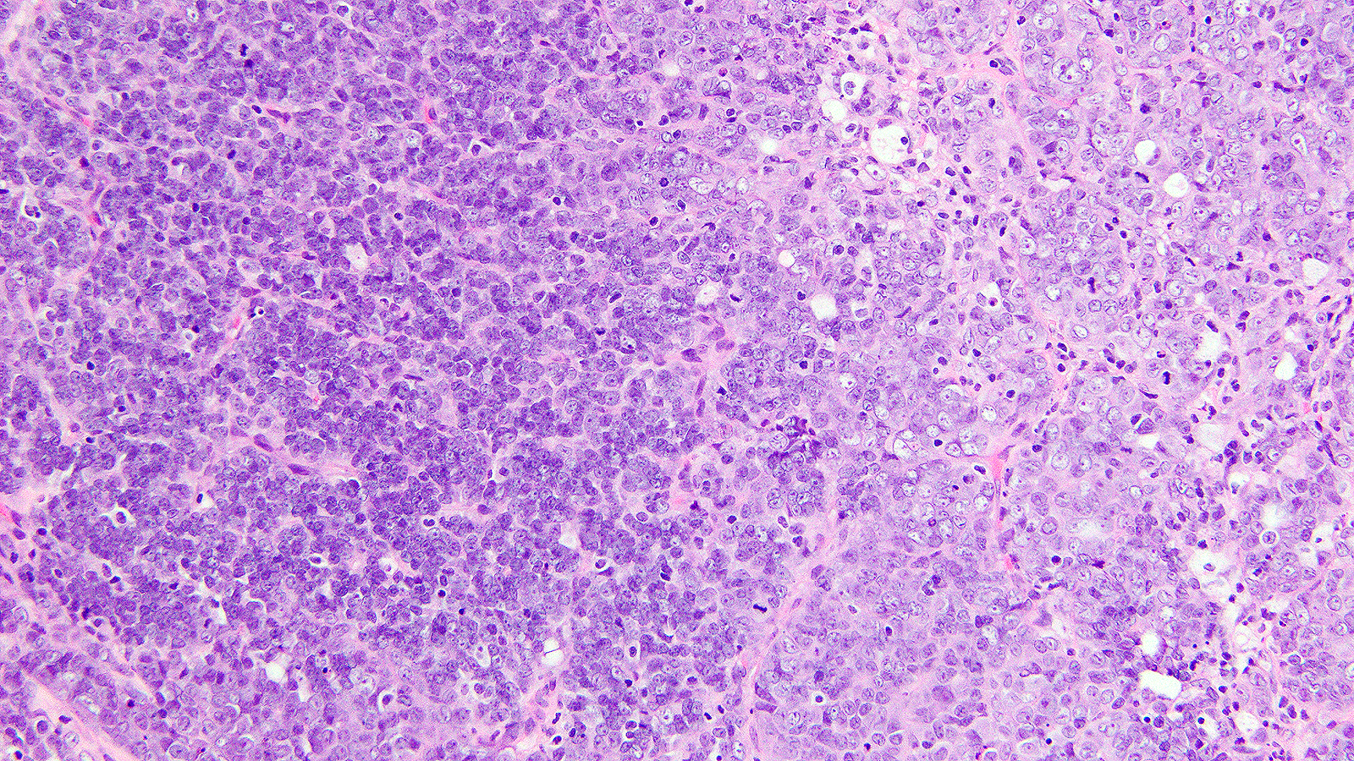

Slide 29
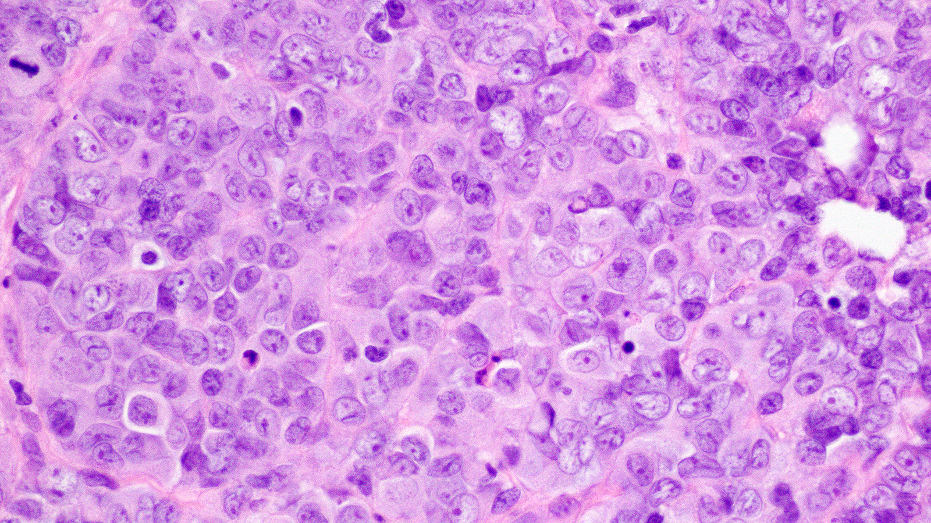
Notes:
Large cells with moderate amounts of eosinophilic cytoplasm, large vesicular nuclei and prominent nucleoli

Slide 30
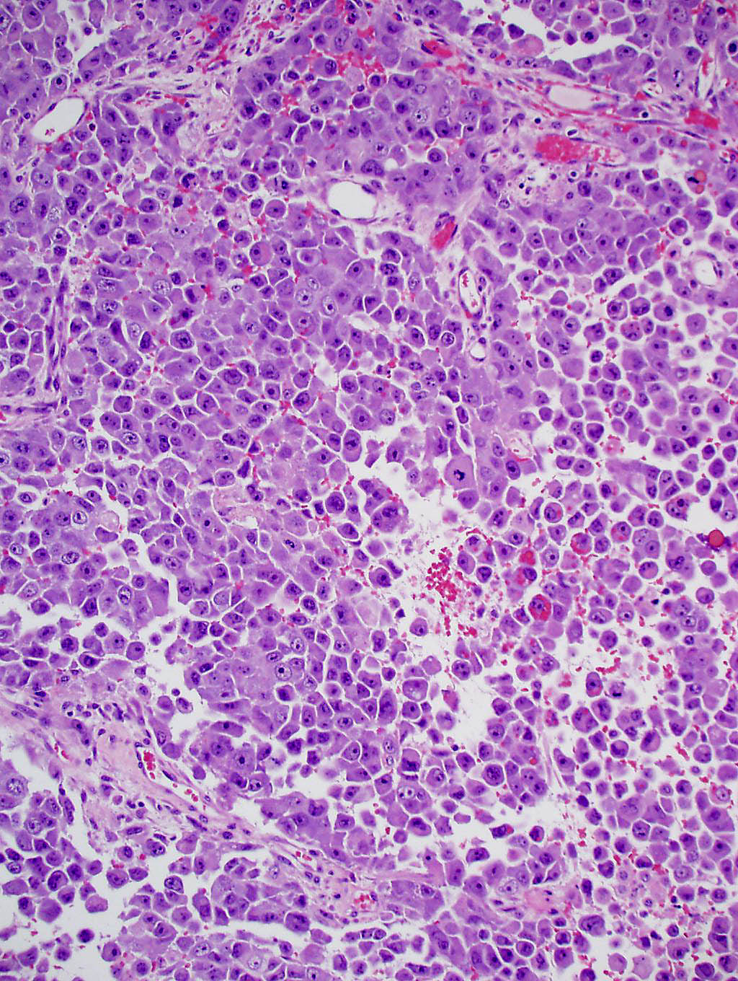
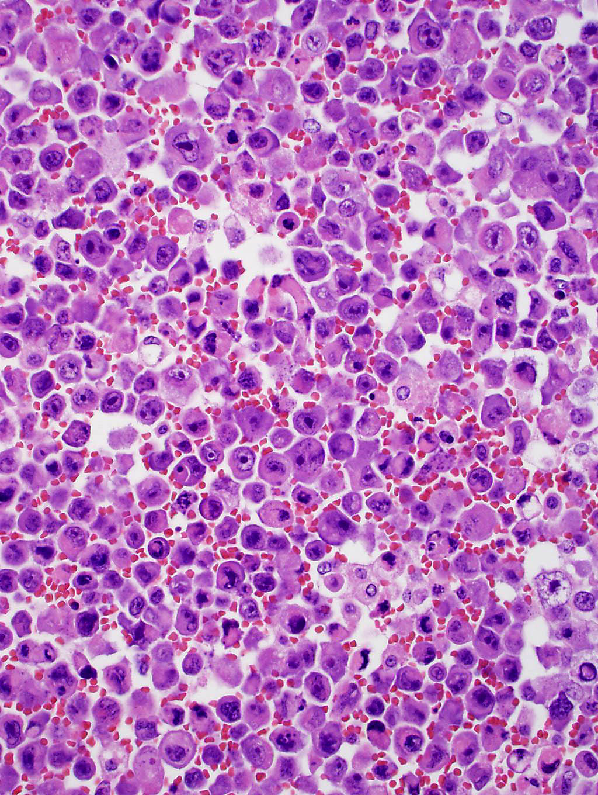
Notes:
dyscohesion

Slide 31
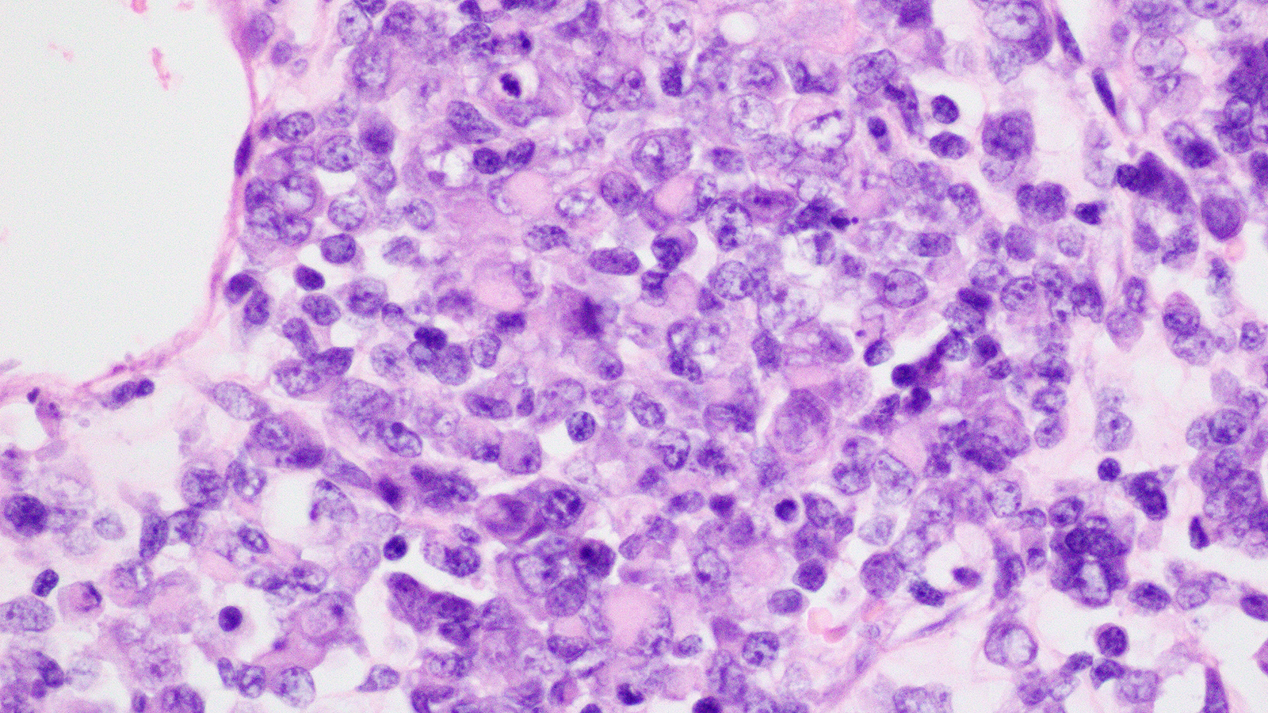
Notes:
Rhabdoid appearance with eosinophilic intracytoplasmic hyaline globules resulting in an eccentric placement of nucleus

Slide 32
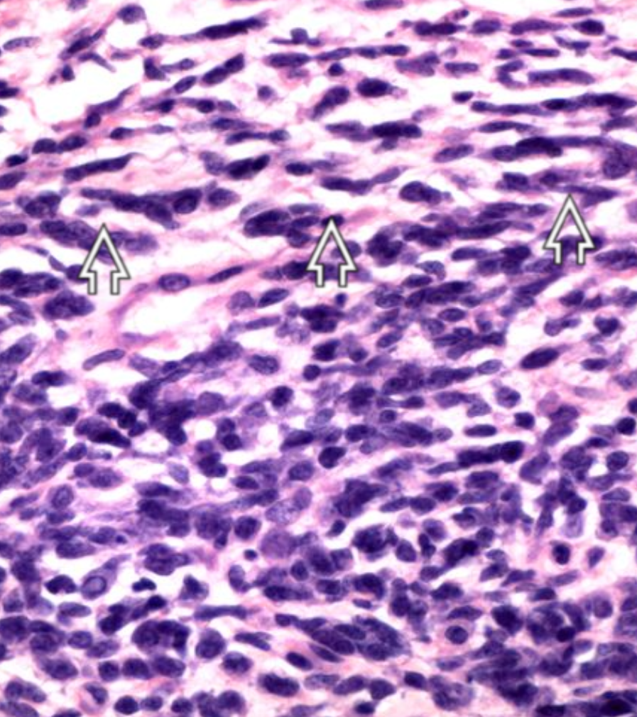
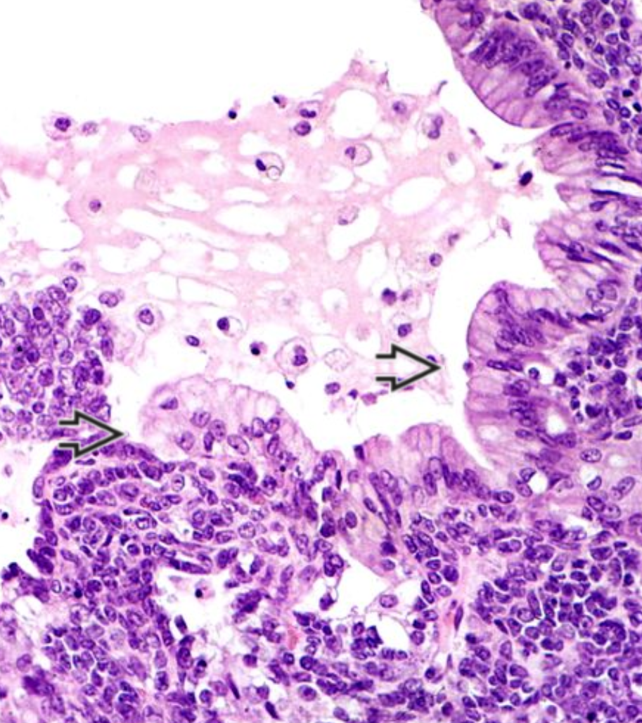
Notes:
A spindle cell component is rare and usually at most a focal finding
Mucinous epithelium seen in <10%, cytology of which ranges from bland endocervical like (less common) to frankly malignant (rarely signet ring cells)

Slide 33
Immunohistochemistry
CAM5.2 > AE1/AE3 (patchy)
EMA may be positive (particularly large cell component)
p53 and p16 diffusely positive
WT1, calretinin, CD10 usually positive
Claudin4 and SALL4 variably positive
Chromogranin, synaptophysin, CD56, NSE may be positive (usually focal)
Inhibin, CD99, TTF1, S100, desmin negative
Notes:
Up until 10 years ago their immunoprofile was non-specific

Slide 34
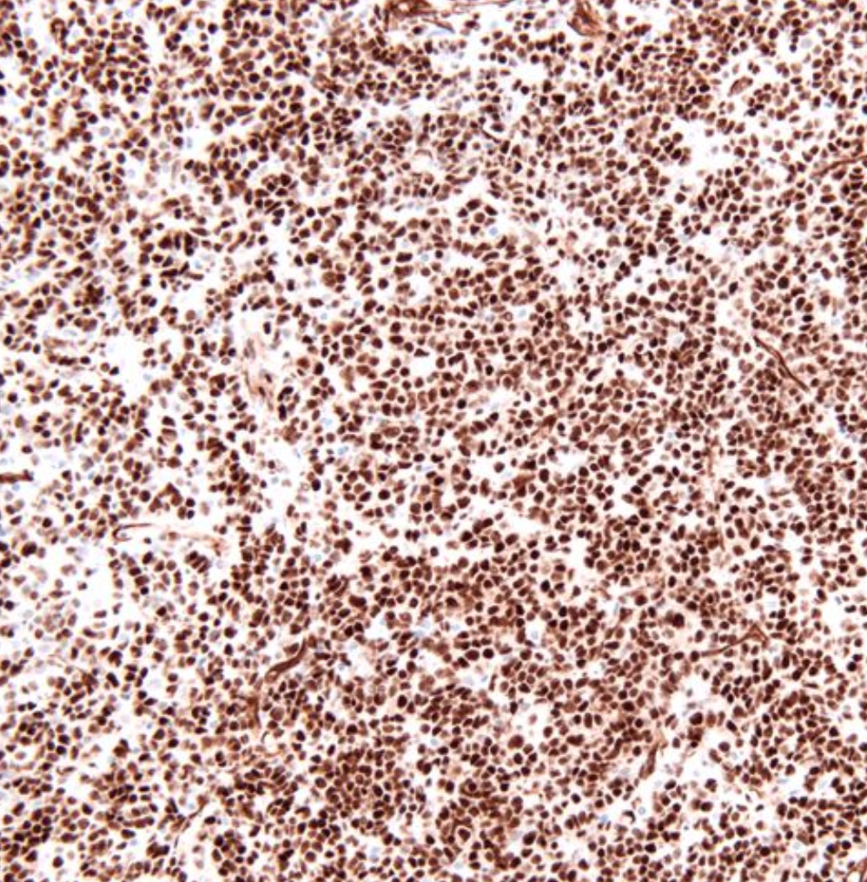
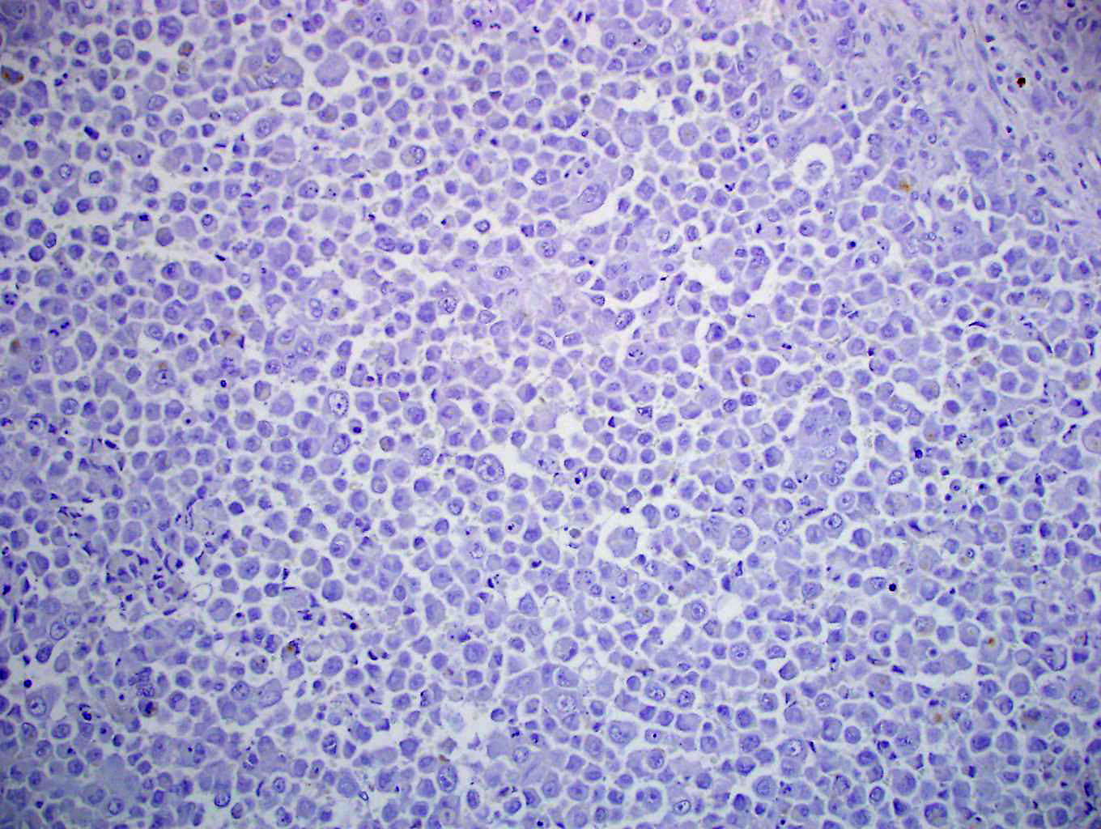
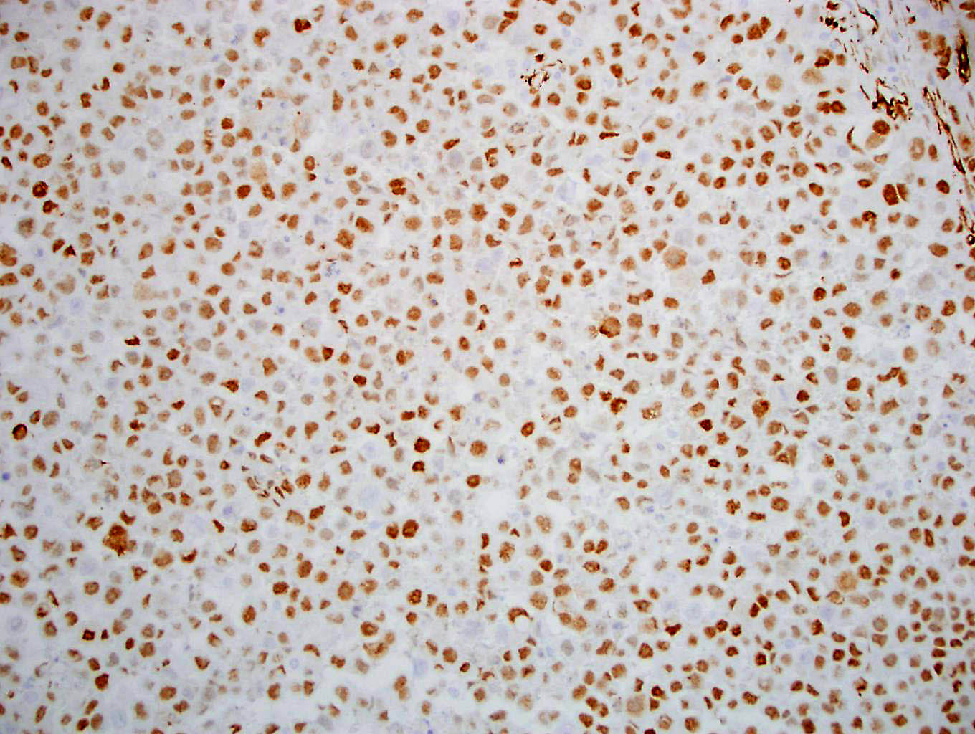
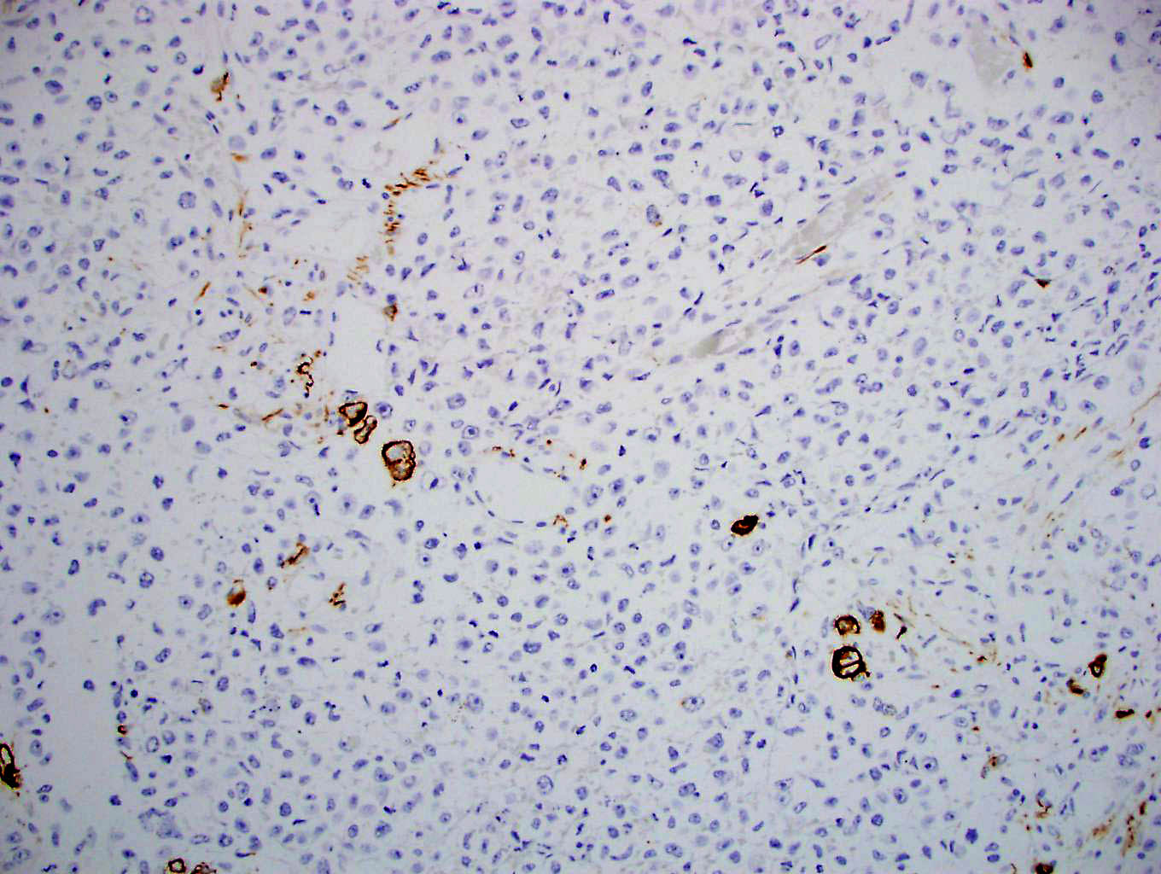
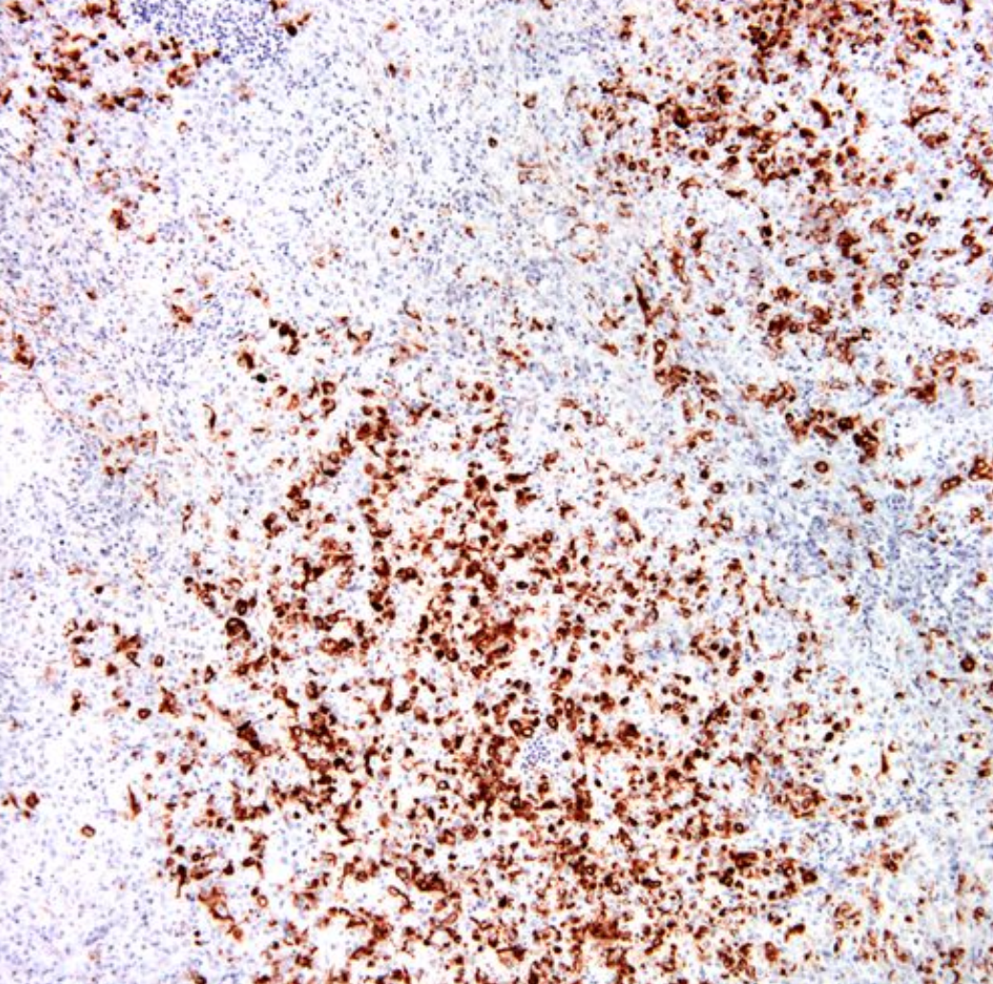
EMA
WT-1
Cam 5.2
Notes:
Up until 10 years ago their immunoprofile was non-specific
Wt-1, CD10 and calretinin are not specific, and as an aside should not be used in DDX with granulosa cell tumor

Slide 35
Differential Diagnosis
Adult/juvenile granulosa cell tumor
Undifferentiated carcinoma
Lymphoma
Melanoma
Germ cell tumors (dysgerminoma)
Neuroectodermal tumor
Desmoplastic small round cell tumor
Metastatic small cell neuroendocrine carcinoma
Notes:
The differential diagnosis is quite broad. Although a tumor with this appearance arising in a young patient with hypercalcemia would prompt most gyn pathologists to think of this diagnosis, these are prone to misdiagnoses because they are so uncommon and many practicing pathologists may not see these or only see these very rarely

Slide 36
Small cell carcinoma of ovary hypercalcemic type is characterized by SMARCA4 mutations
Biallelic loss of SMARCA4
  Germline mutation + somatic mutation
  Somatic mutation + LOH
  Two somatic mutations
43% of patients carry a germline SMARCA4 mutation (26/60)
Jelinic, P. et al. Nat. Genet. 46, 424–426 (2014).
Ramos, P. et al. Nat. Genet. 46, 427–429 (2014).
Witkowski, L. et al. Nat. Genet. 46, 438–443 (2014).
Witkowski, L. et al. Gynecol. Oncol. 141, 454–460 (2016).
Notes:
And in fact almost half of patients with SCCOHT carry a germline mutation for SMARCA4 and for that reason one should recommend germline testing when a patient is diagnosed with this tumor

Slide 37
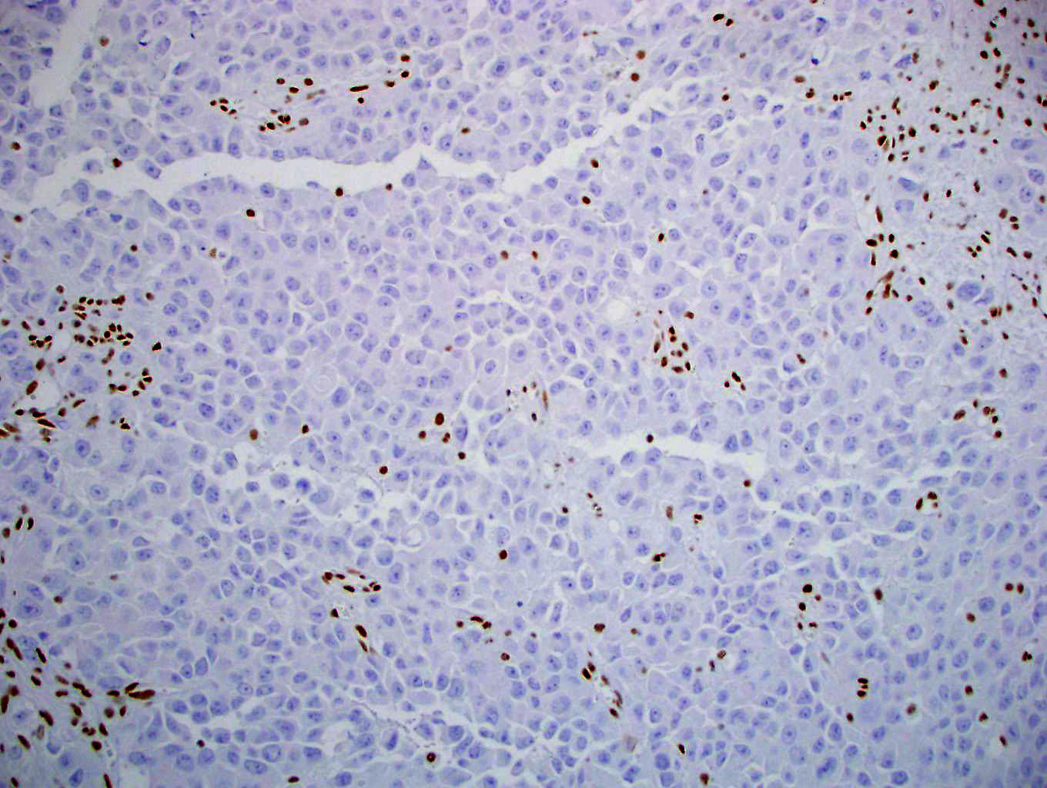
EMA
WT-1
Cam 5.2
SMARCA4
Notes:
As most of you probably know there is a great immunohistochemical marker available for SMARCA4 and in the ovary it is quite sensitive and specific for the diagnosis of SCCOHT. This marker helps establish the diagnosis and can be a tremendous aid for those that don’t see these as often. Interpretation is to see loss of staining with background stroma or lymphocytes acting as a nice internal positive control

Slide 38
Immunohistochemistry as a sensitive marker of SWI/SNF deficiency
SMARCA4
SMARCB1
ARID1B
ARID1A
Notes:
There are also stains available for other components of the SWI/SNF complex, SMARCb1, ARID1B and ARID1A and they are useful to have as they are more sensitive than sequencing for detecting these abnormalities. Sometimes sequencing may only show one mutation but the IHC is lost indicating biallelic inactivation

Slide 39
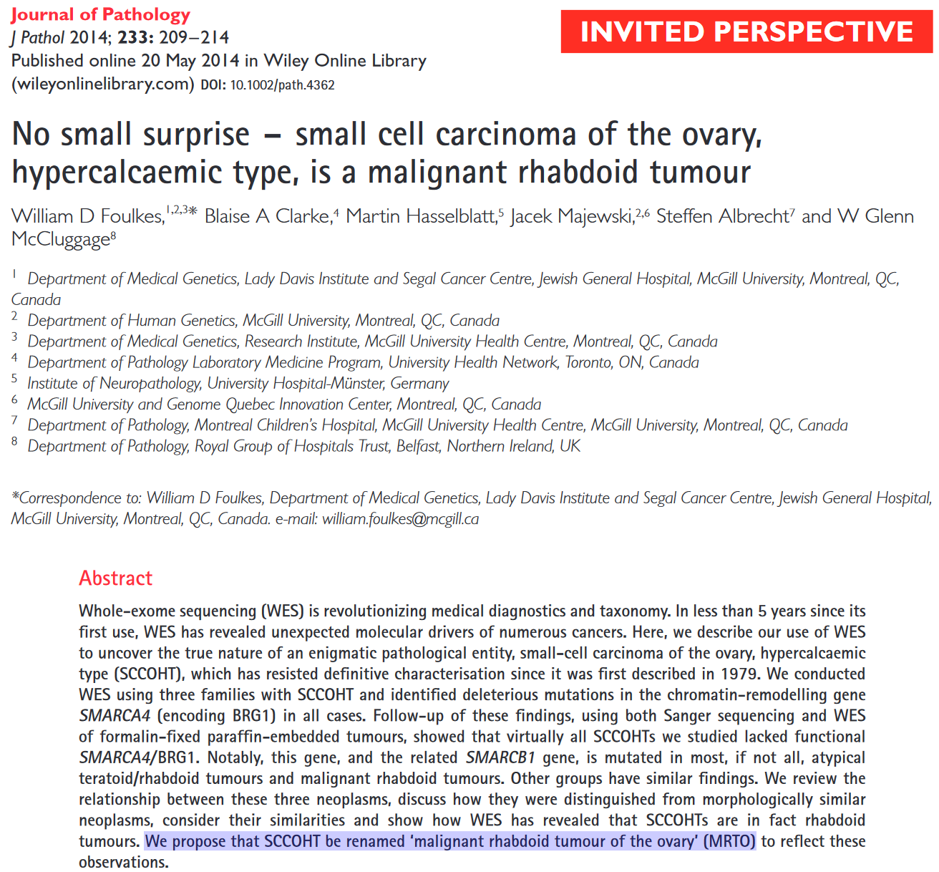
Notes:
Prior to 2014, there was discussion in the literature as to whether or not these were carcinomas or perhaps germ cell tumors because they arose in young patients and showed patchy SALL4 positivity but in 2014 there was a movement by several groups of pathologists to rename these as malignant rhabdoid tumors of the ovary because they show limited keratin expression, they happen in young patients, they are associated with only a single genetic abnormality, which is inactivation of the SWI/SNF complex just like rhabdoid tumors, so it was argued that it should be renamed. This never was really accepted probably because the terminology of tumor as SCCOHT is so entrenched in the literature and in practice. But their points are well taken. And in the current WHO, SCCOHT is not in the carcinoma nor the mesenchymal section but in the “miscellaneous” tumors of the ovary

Slide 40
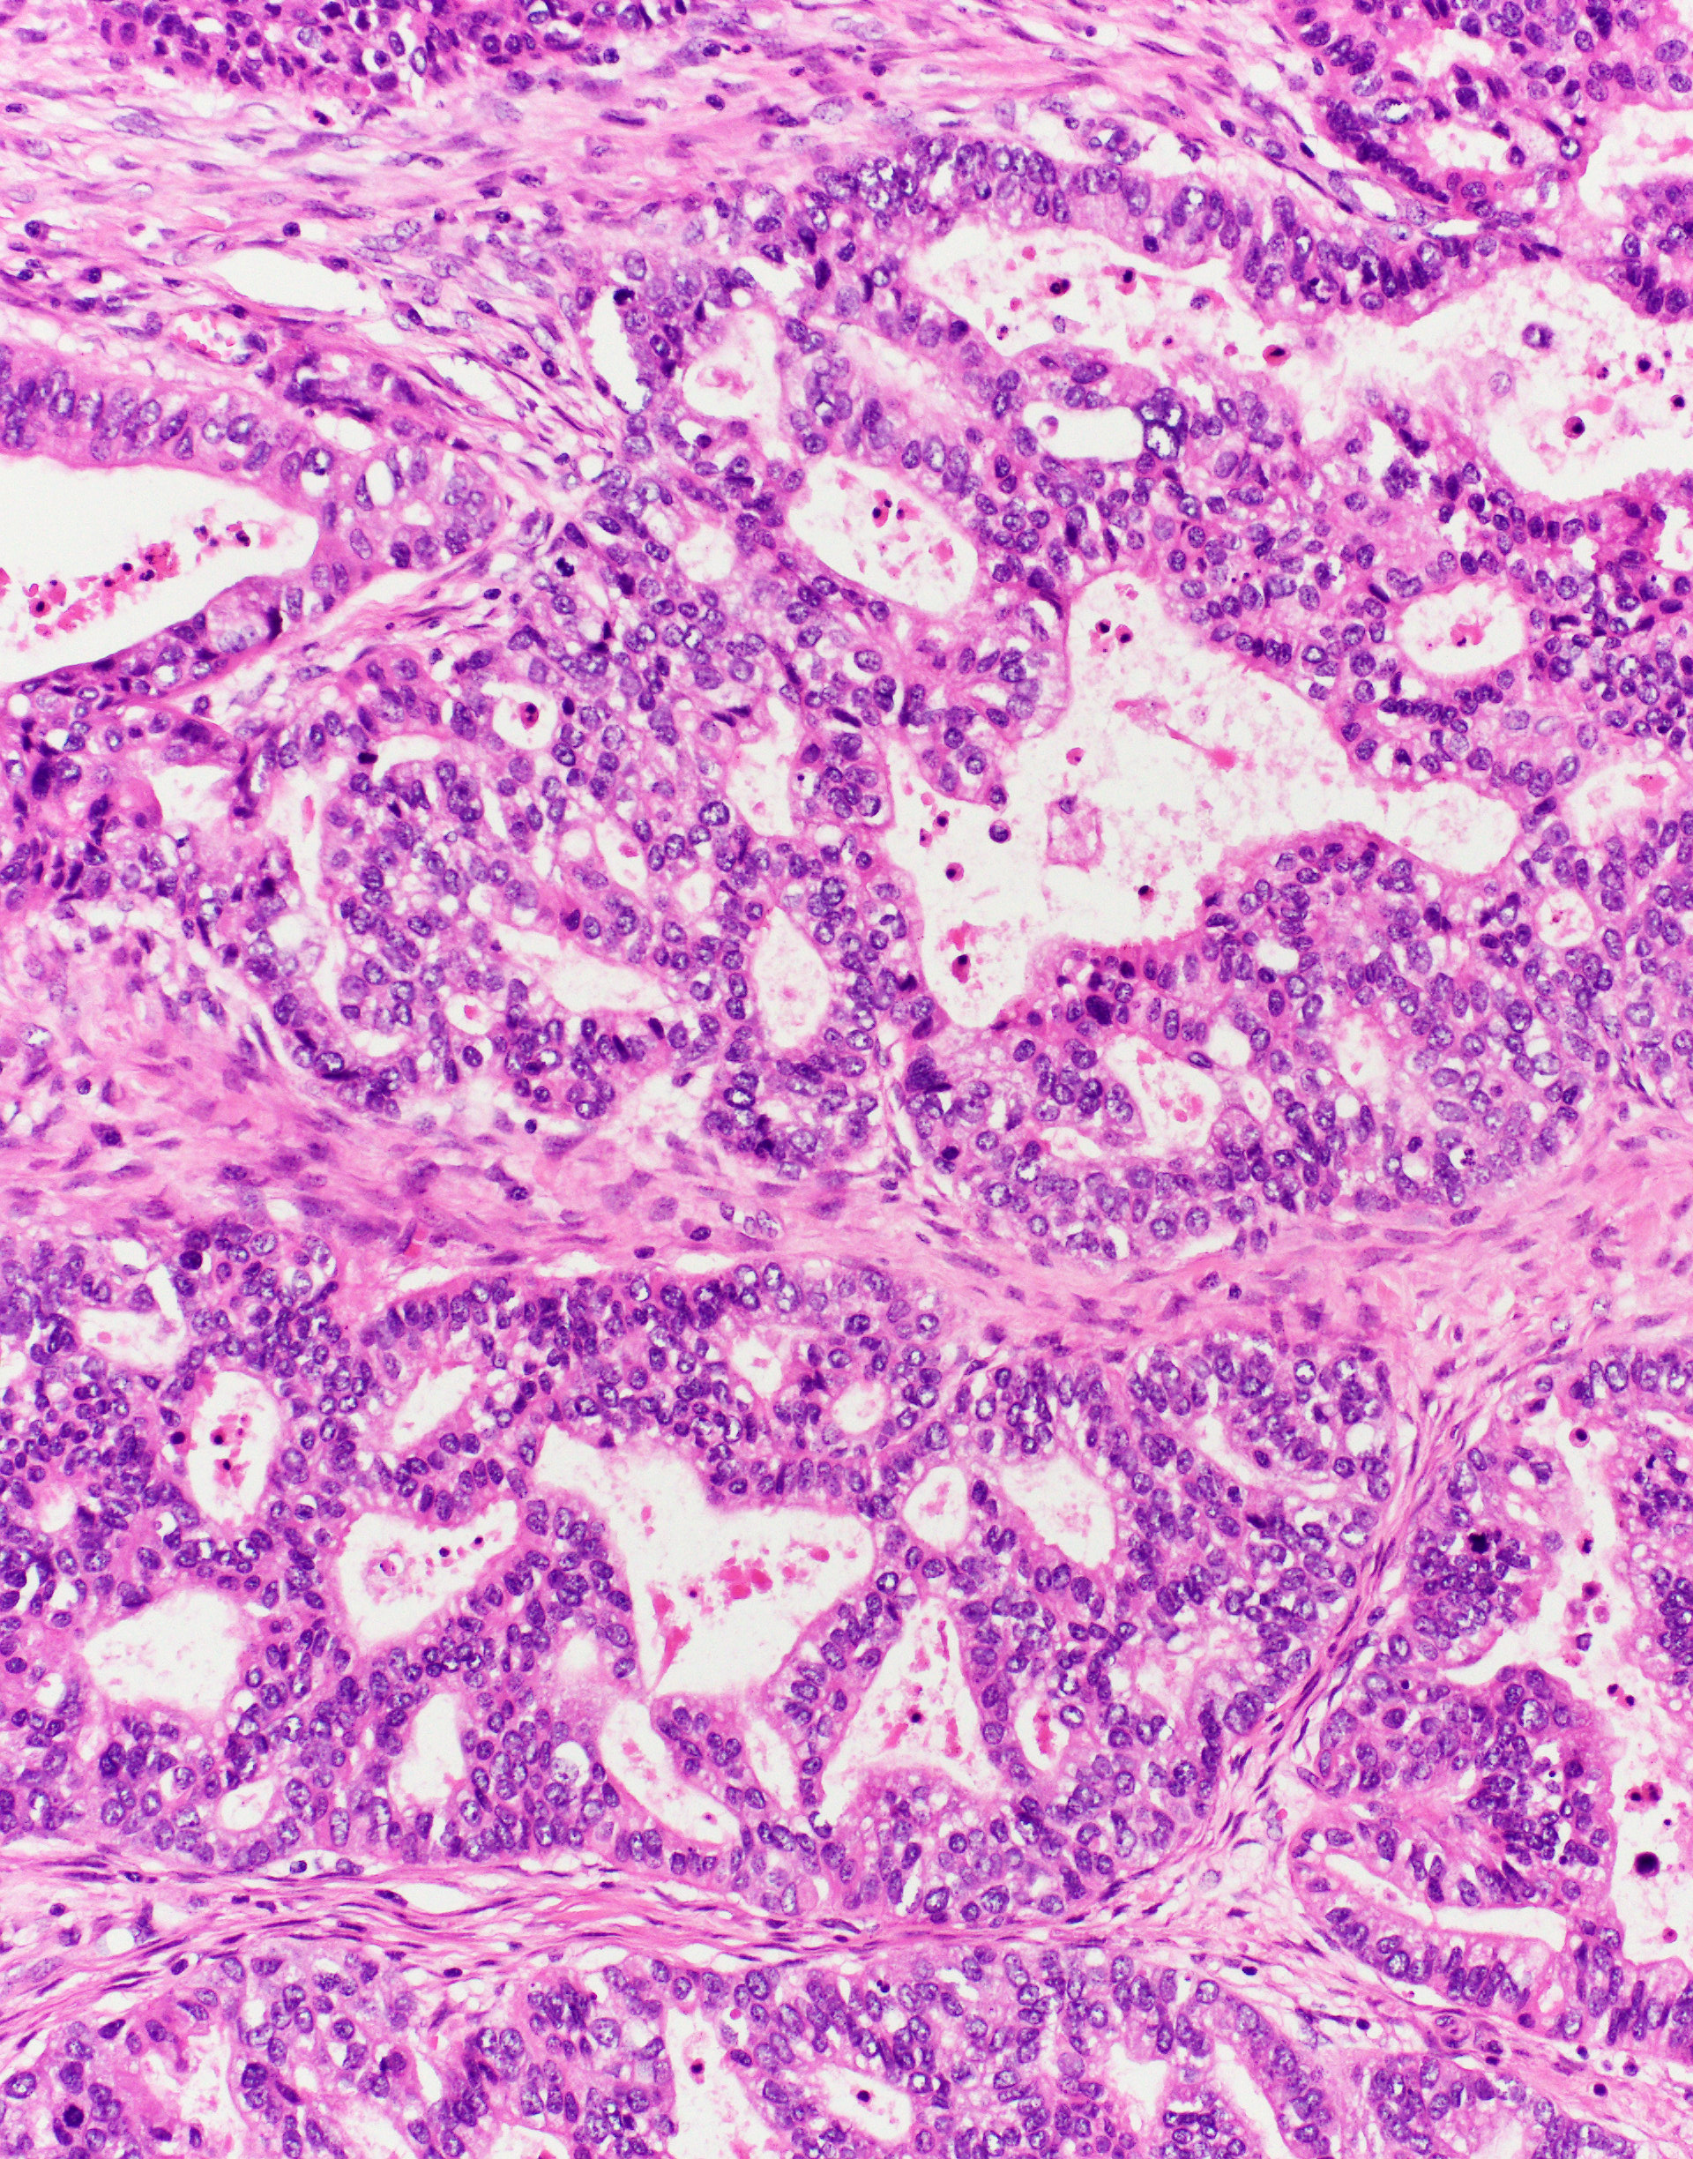
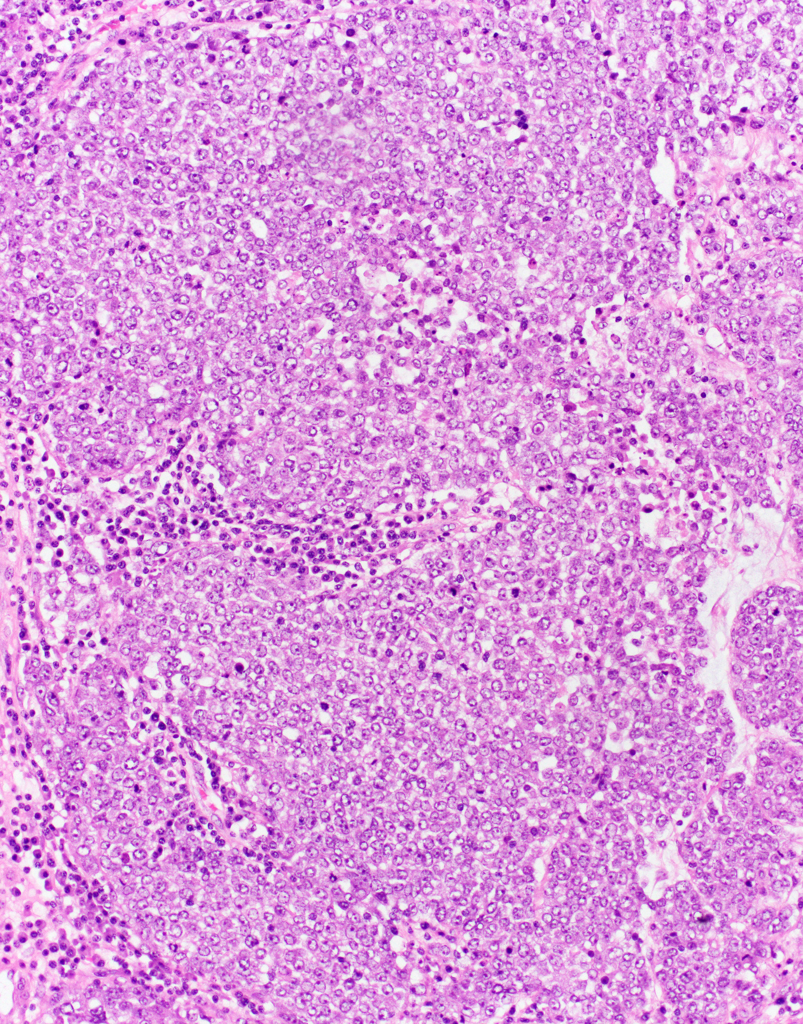
Dedifferentiated ovarian carcinoma
Well-differentiated
Undifferentiated
Silva E, et al. Int J Gynecol Pathol. 2006;25(1):52-8.
Tafe L, et al. Mod Pathol. 2010;23, 781-789.
Notes:
Moving on to dedifferentiated ovarian carcinoma, this is a biphasic tumor composed of a well differentiated component and an undifferentiated component that arises from the well differentiated component

Slide 41
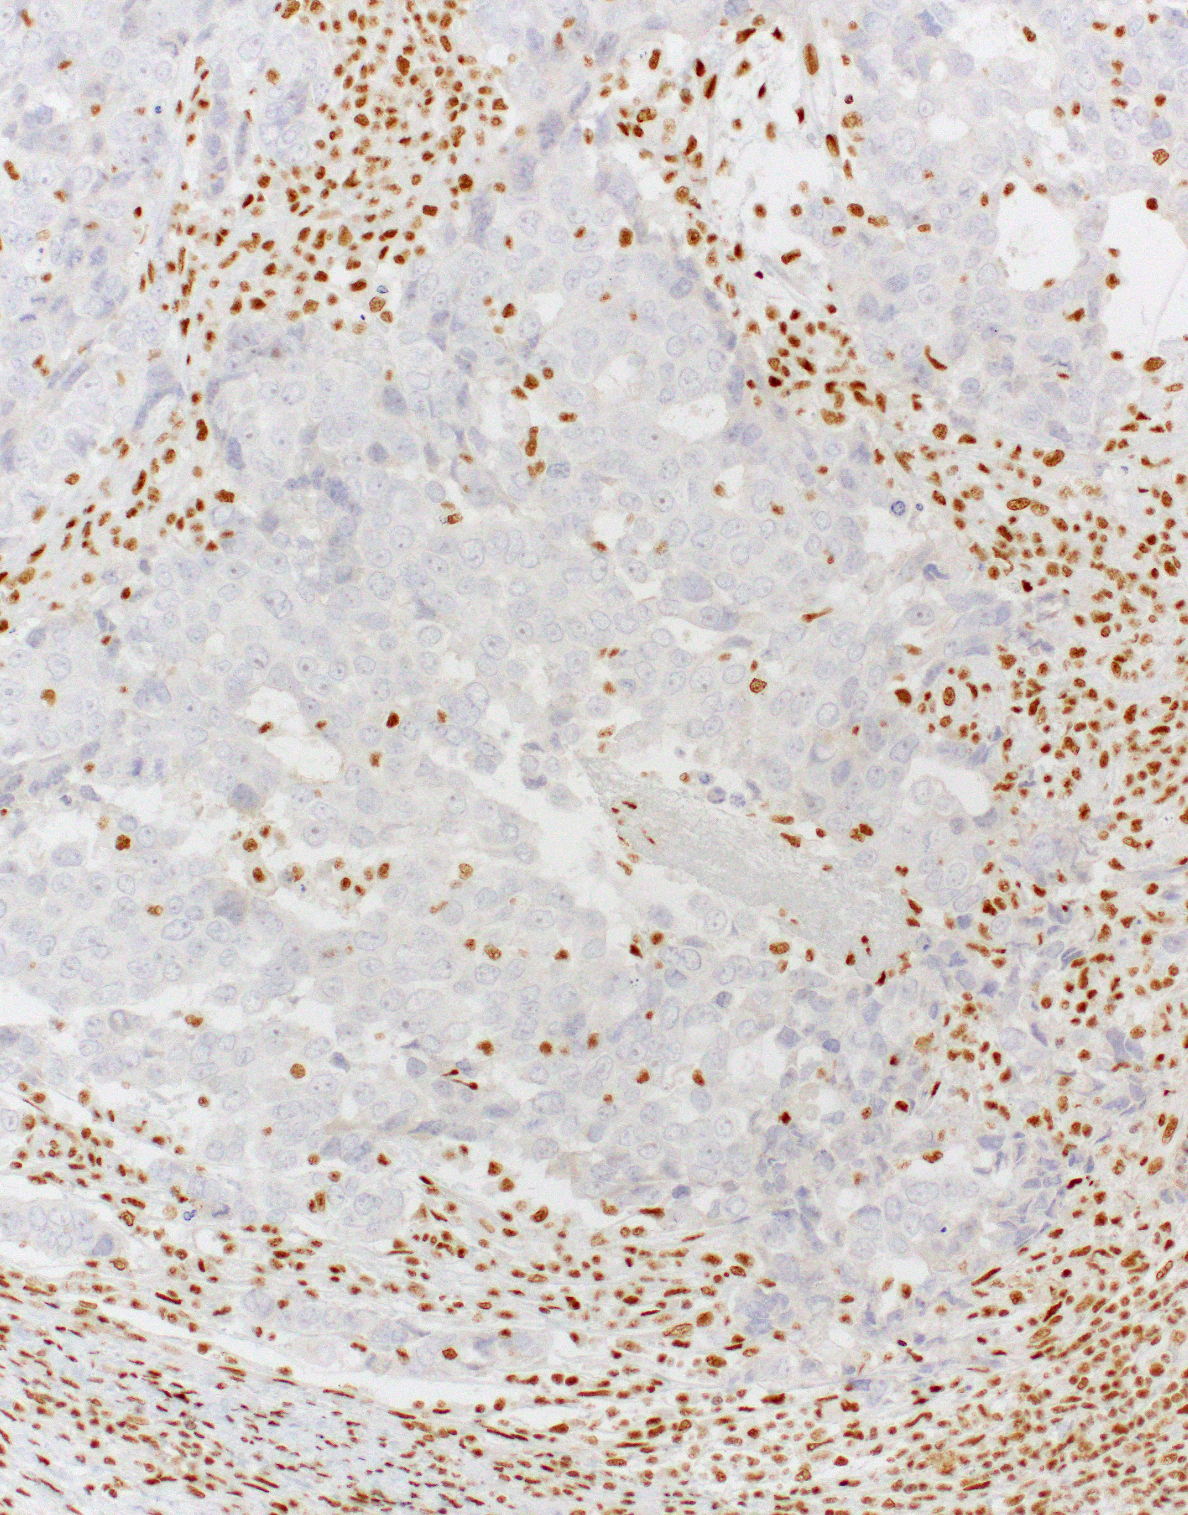
Dedifferentiated ovarian carcinoma
Well-differentiated
Undifferentiated
SMARCB1
Silva E, et al. Int J Gynecol Pathol. 2006;25(1):52-8.
Tafe L, et al. Mod Pathol. 2010;23, 781-789.
Notes:
And these undifferentiated areas show loss of the components of the SWI/SNF complex such as SMARCB1 in this example

Slide 42
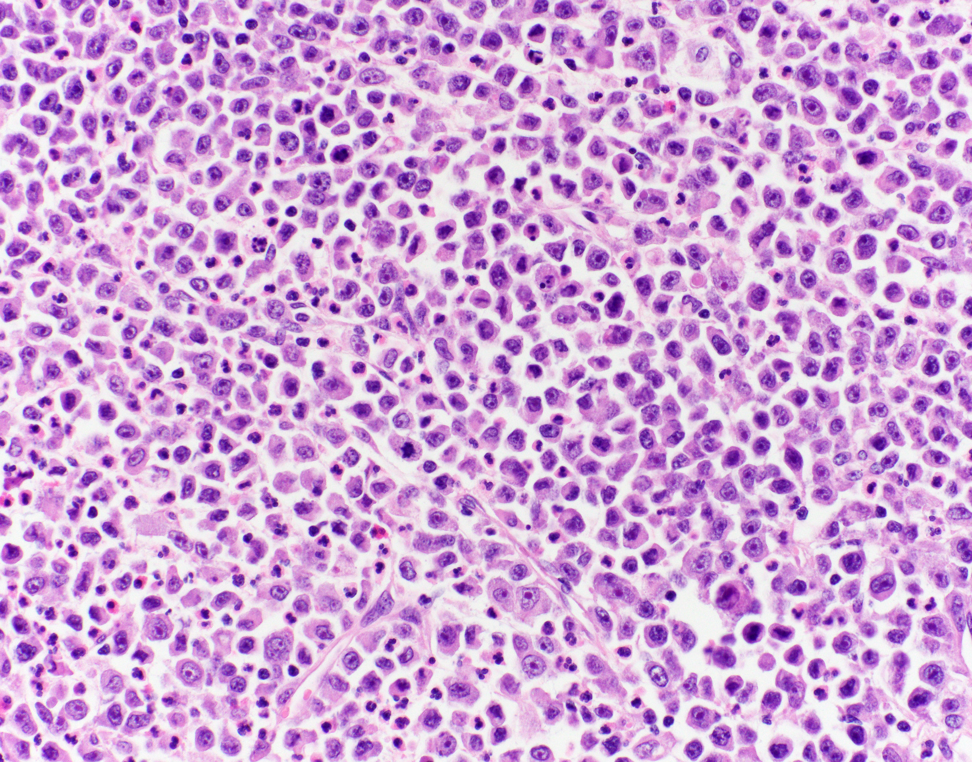
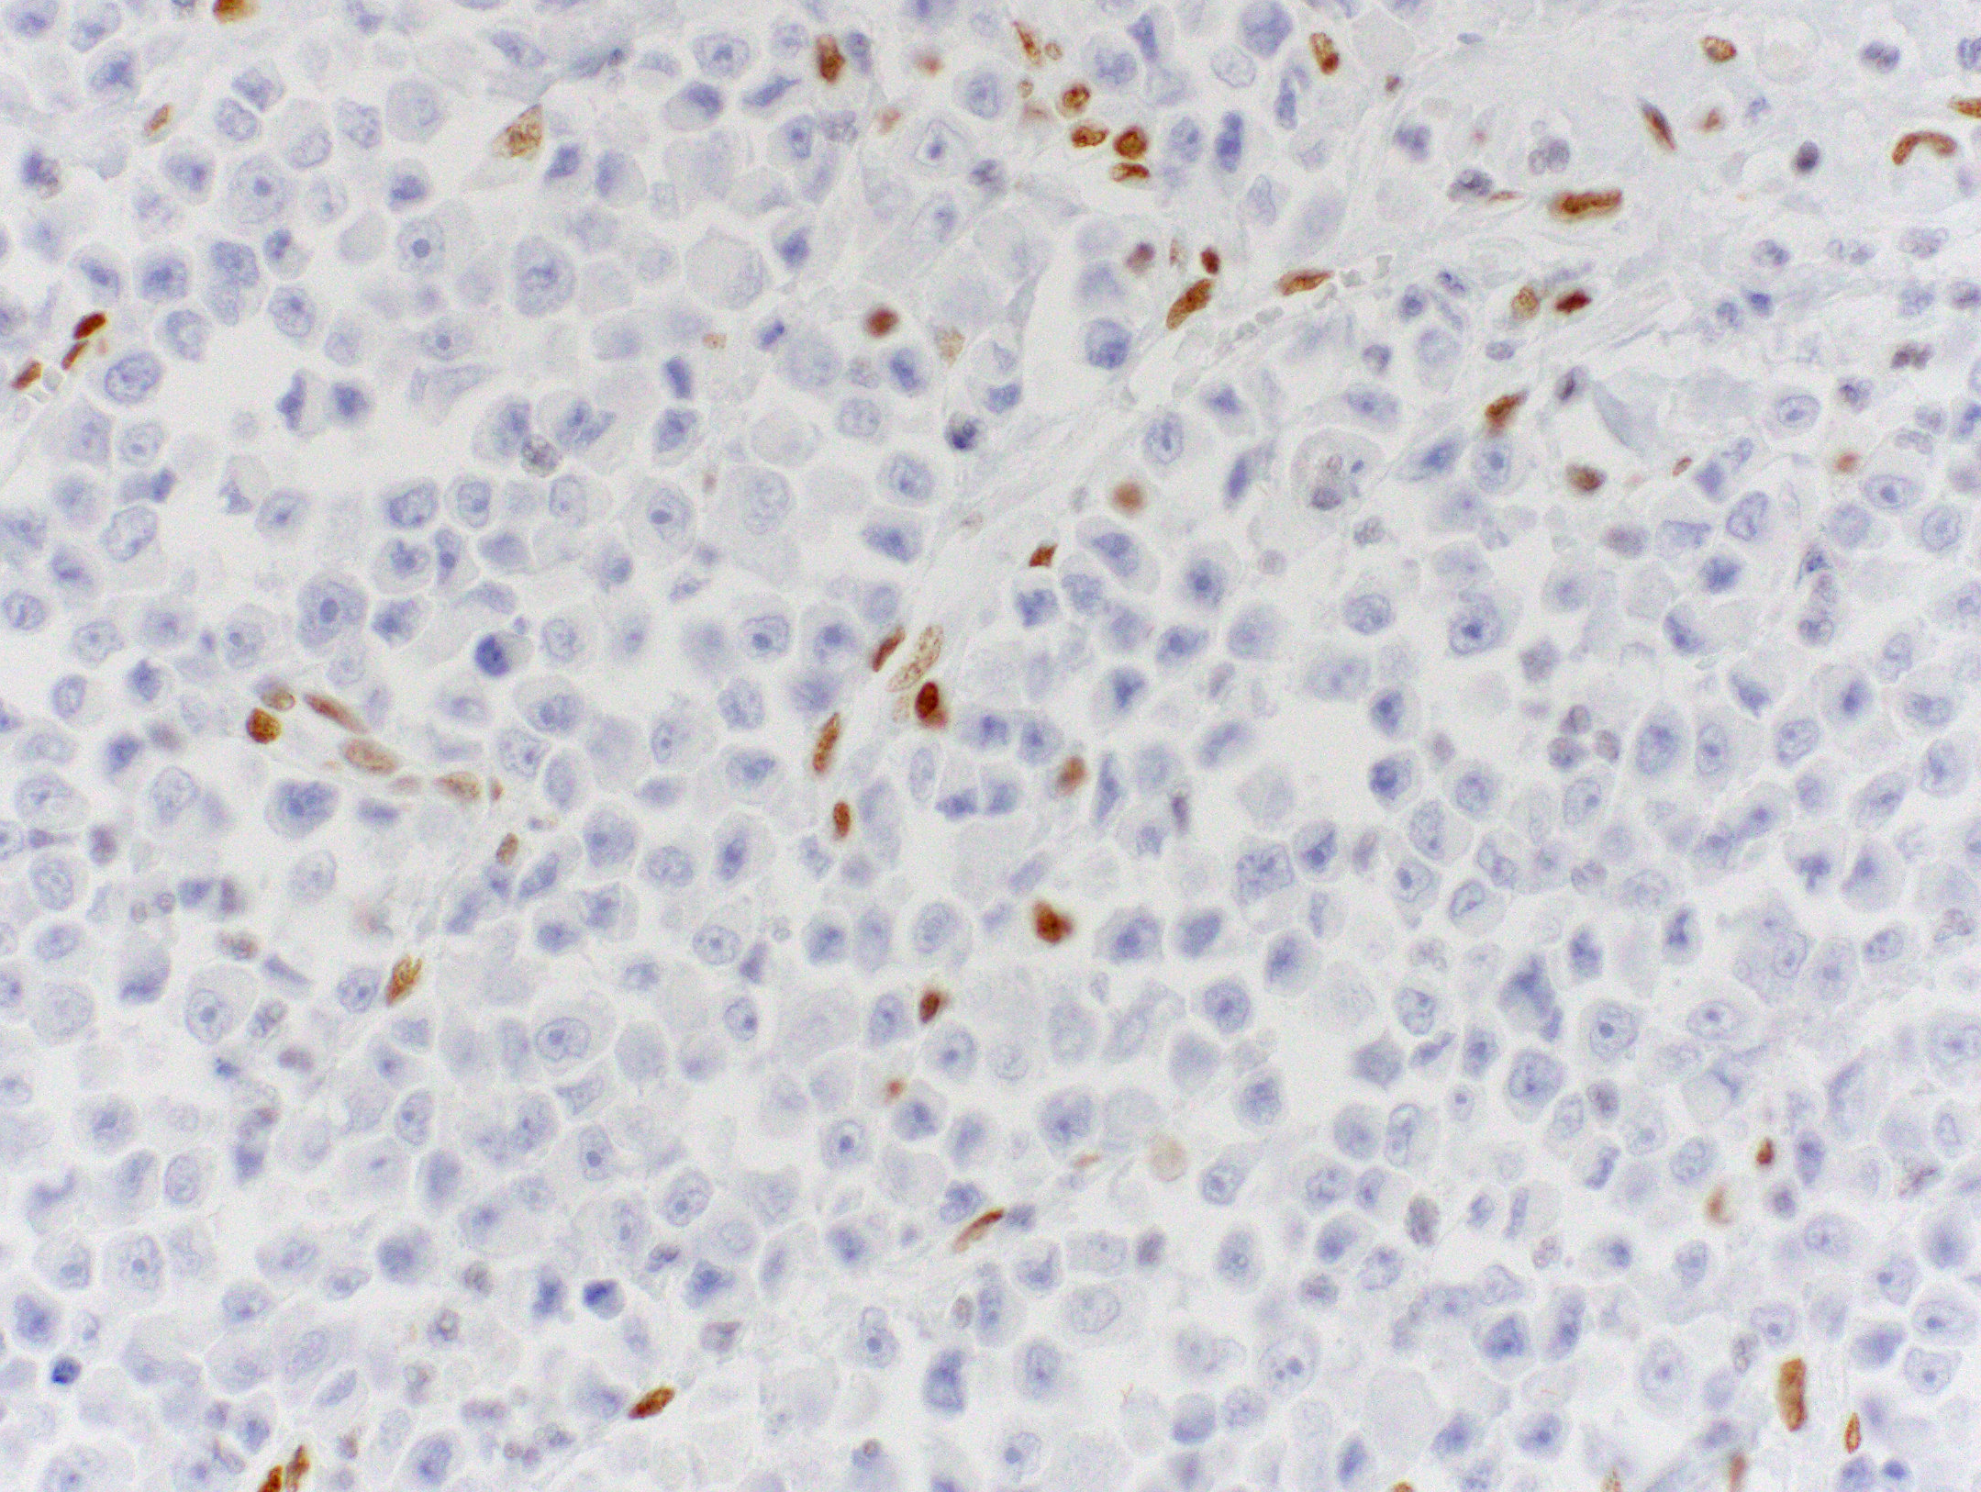
Undifferentiated ovarian carcinoma
SMARCA4
Notes:
In some cases, even with extensive sampling there is no well differentiated component seen and the entire tumor looks like an undifferentiated carcinoma and the thought is that these probably arose from a well differentiated carcinoma but they have overgrown that component

Slide 43
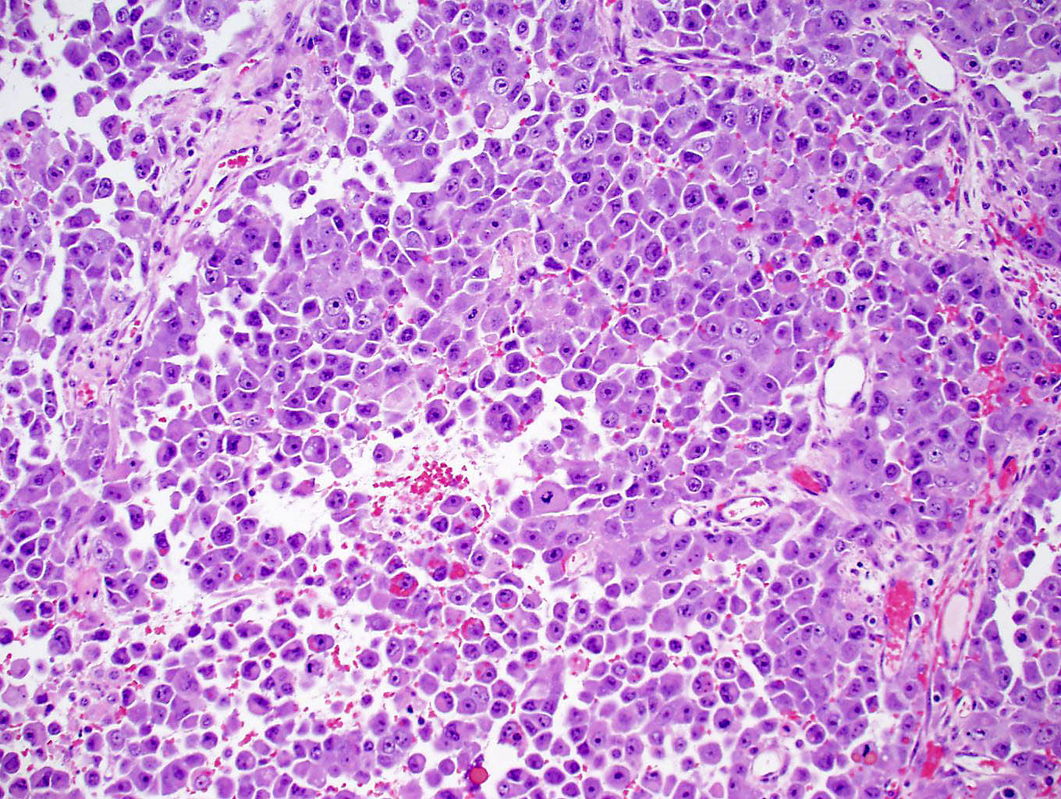
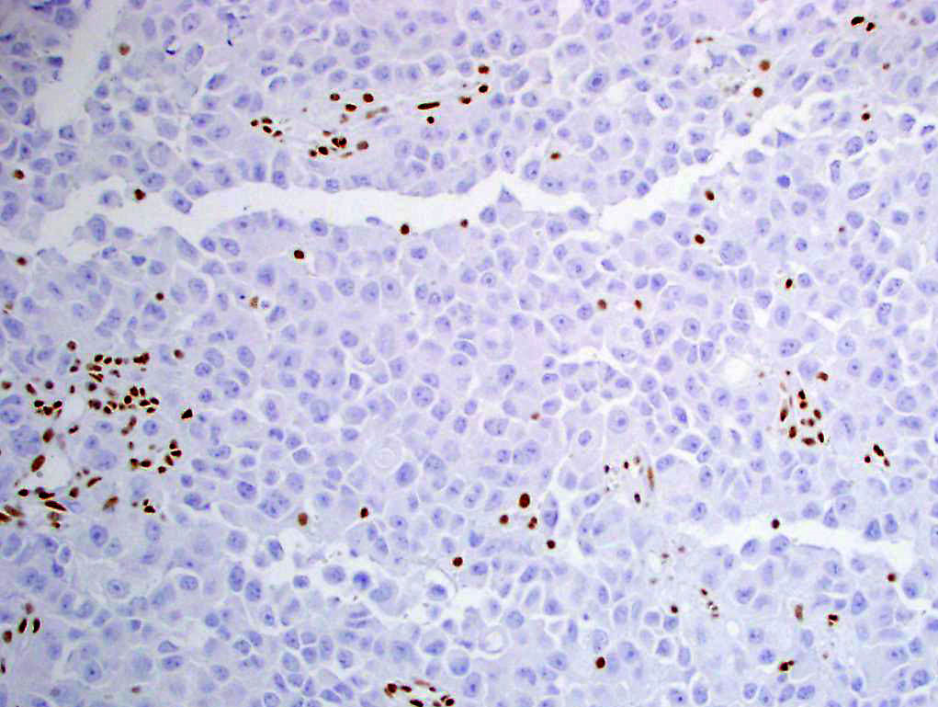
Undifferentiated ovarian carcinoma
Small cell carcinoma of the ovary, hypercalcemic type
SMARCA4
SMARCA4
Notes:
This does bear resemblance to SCCOHT as both tumors show similar morphology, both show lack of keratin expression and both are characterized by loss of SMARCA4 so one wonders whether they are related or potentially the same tumor or are different entities

Slide 44
Dedifferentiated ovarian carcinoma
Cohort of 20 dedifferentiated and 3 undifferentiated ovarian carcinoma
22 to 71 (mean 50) years
18/22 (82%) showed loss SWI/SNF proteins:
  10 with co-loss ARID1A/1B
  7 with loss of SMARCA4
  1 with loss of SMARCB1 expression
6/23 (26%) MMR-deficient
70% had extra-ovarian spread at presentation
Follow-up available for 19 patients
  Median disease specific survival: 4 mo
  17/19 dead of disease
Tessier-Cloutier B, et al. Mod Pathol Jan 2024
Notes:
To help clarify this, one of my colleagues David Kolin contributed some BWH cases to this study which was just recently published in Mod Pathol which looked at a cohort of….and compared them to SCCOHT
Dediff and undif occurred in older patient with a mean age of 50 compared to SCCOHT (mean 24). They do frequently show loss of SWI/SNF proteins, a quarter are mismatch repair deficient, very aggressive

Slide 45
Methylation analysis of dedifferentiated ovarian carcinoma
Tessier-Cloutier B, et al. Mod Pathol Jan 2024.
Notes:
Methylation analysis was performed on the de and undifferentiated tumors and compared to SCCOHT as well as HGSC and you can see that the de and undifferentiated carcinomas show copy number alterations (demonstrated by the red and blud bars as gains and losses) that are intermediate to those of SCCOHT and HGSC, the latter of which of course is characterized by p53 mutations and genomic instability

Slide 46
Methylation analysis of dedifferentiated ovarian carcinoma
Notes:
And methylation analysis showed that the DDOC/UD ovarian tumors, even though they contain SMARCA4 inactivation like SCCOHT, do cluster separately suggesting that they are indeed distinct from SCCOH

Slide 47
Mucinous tumors associated with anaplastic carcinoma
Anaplastic carcinoma rarely associated with mucinous tumors
  Rhabdoid
  Pleomorphic
  Sarcomatoid
Ovary (n=22), retroperitoneum (n=3)
SWI/SNF loss in 9/25 (36%)
  SMARCA2/4, ARID1A, SMARCB1
SWI/SNF loss not associated with death from disease (3/5 vs 1/12; p=0.053)
Chaudet K, et al. Histopathology. 2020;77(2):231-239.
Notes:
I also wanted to mention SWI/SNF loss in other ovarian tumors. Mucinous ovarian tumors can rarely be associated with malignant mural nodules of anaplastic carcinoma. Upper left panel A shows this phenomenon where there is mucinous lining on the top and subjacent to that is a nodule of anaplastic carcinoma, which can have a variety of morphologic appearances including rhabdoid, as seen in panel B, which is evocative of SWI/SNF inactivation and indeed there is SWI/SNF loss in about 1/3 of these tumors. Although not statistically significant there was a trend that these may act more aggressively. In fact, the one patient with SMARCB1 loss and clinical follow-up had died of disease four months after diagnosis

Slide 48
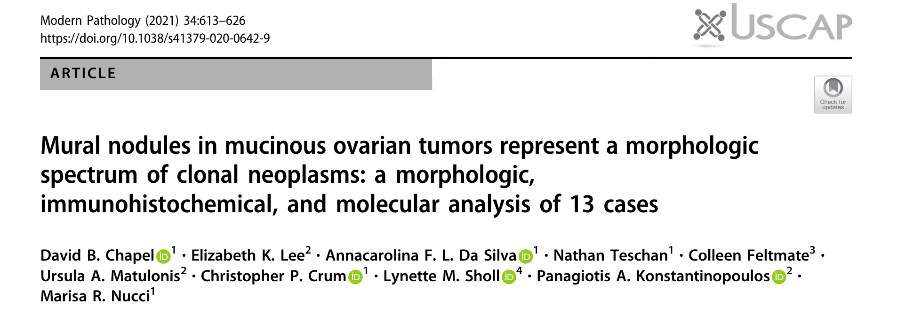
13 cases with anaplastic mural nodules; one showed a non-shared deleterious mutation in SMARCB1 with fatal outcome
Notes:
we identified a non-shared deleterious SMARCB1 mutation in one anaplastic carcinomatous nodule with a fatal outcome
Additional studies are indicated to better characterize the pathogenetic role of SWI/SNF alterations in mural nodules arising in mucinous ovarian tumors, as well as the prognostic value of SWI/SNF immunohistochemistry, particularly in stage IA tumors.

Slide 49
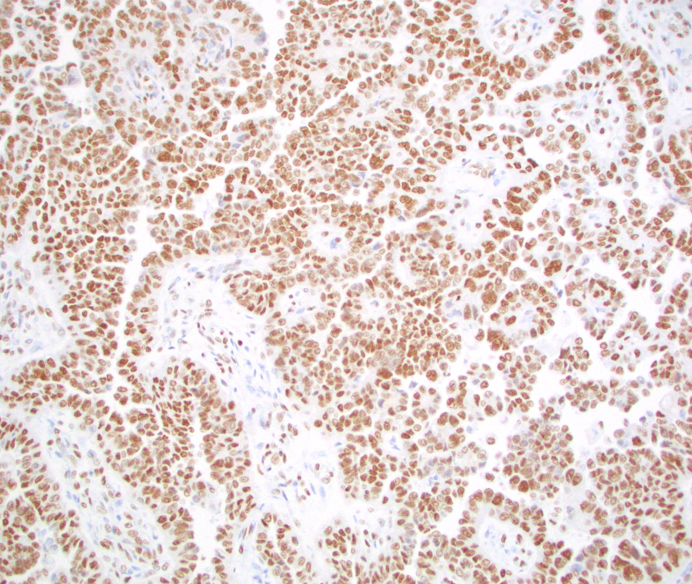
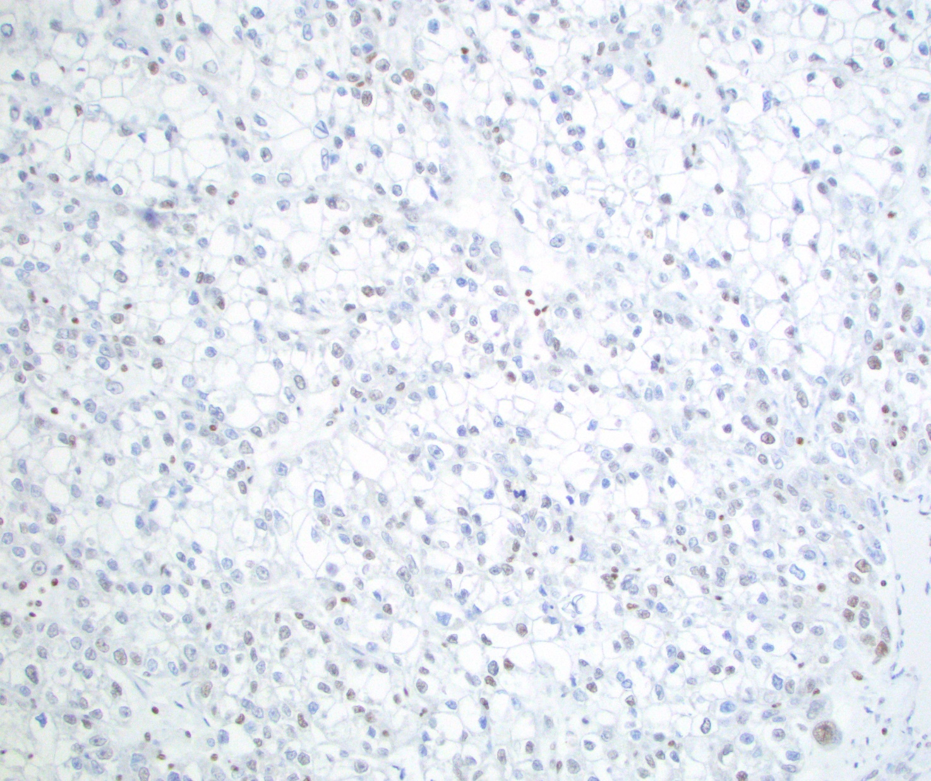
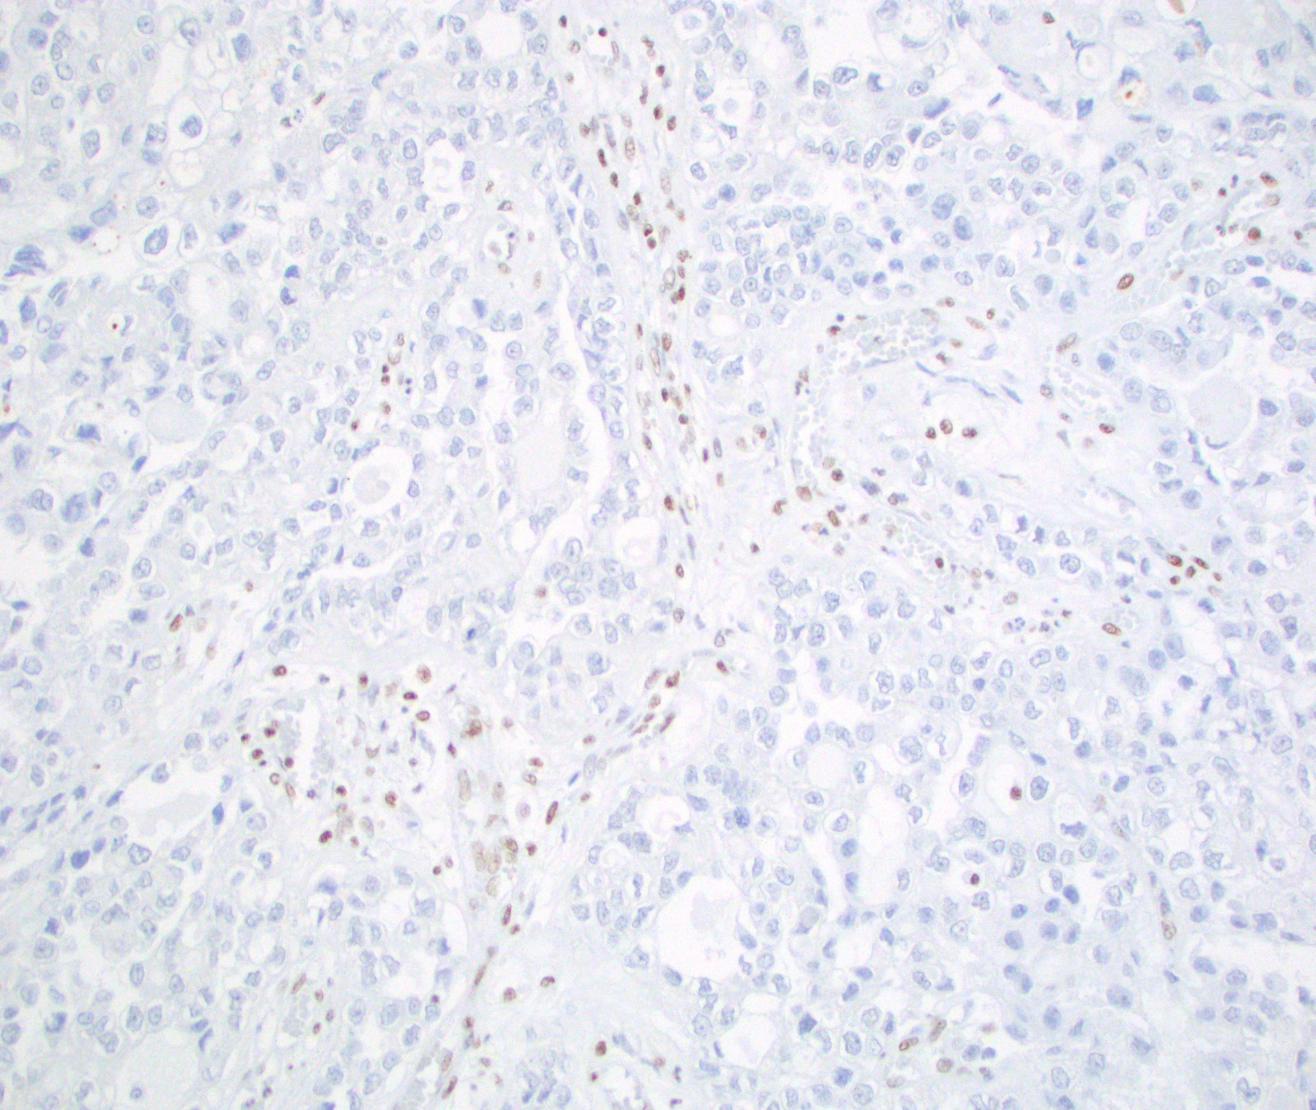
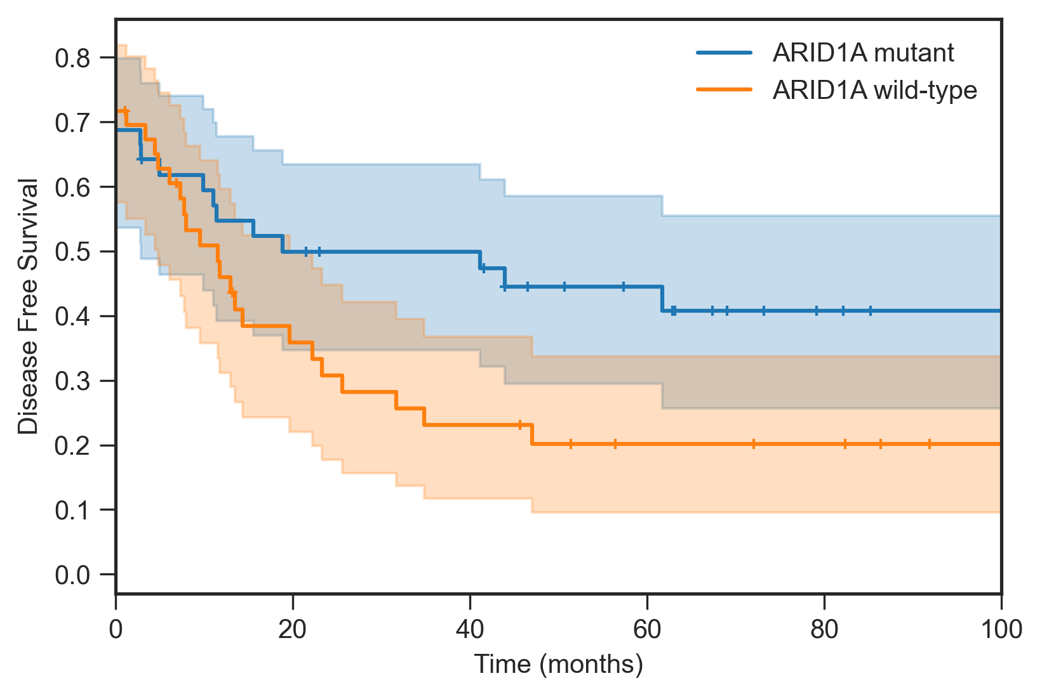
ARID1A in Mullerian Clear Cell Carcinomas
Intact
Diminished
Lost
 |  | ARID1A WT | ARID1A mutant
ARID1A IHC | Intact | 27 | 5
 | Diminished | 1 | 4
 | Lost | 4 | 21
p=0.14
Sensitivity of 83%
Specificity of 84%
Irshaid L, et al. Mod Pathol. 2023;36(5):100123.
Notes:
Just a few words about another member of SWI/SNF complex ARID1A and ovarian cancer. ARID1A has been looked at in many types of cancers including those in the GYN tract and it is in fact inactivated in many ovarian clear cell carcinomas and endometrioid carcinoma and the IHC is a pretty good surrogate marker for the underlying mutation but having said that at least in the GYN tract it doesn’t seem to have any diagnostic, prognostic or predictive significance so I am not going to further address it. But be aware it can be mutated in these tumors and unlike the other members of the SWI/SNF complex, when it is inactivated the tumors are usually well differentiated whereas with the other components it is associated with dedifferentiation

Slide 50
SWI/SNF tumors of the gynecologic tract
Small cell carcinoma of the ovary, hypercalcemic type (SMARCA4)
De/undifferentiated ovarian carcinoma (SMARCA4/B1, ARID1A/B)
Clear cell/endometrioid carcinoma (ARID1A)
Anaplastic ca in mucinous tumors (SMARCA4, ARID1A, SMARCB1)
De/undifferentiated endometrial carcinoma (SMARCA4/B1, ARID1A/B)
Clear cell/endometrioid carcinoma (ARID1A)
SMARCA4-deficient uterine sarcoma
Proximal-type epithelioid sarcoma (SMARCB1)
Myoepithelial carcinoma (SMARCB1)
Myoepithelioma-like tumor of the vulvar region (SMARCB1)
Vulvar yolk sac tumors (SMARCB1)
Notes:
So in addition to SCCOHT and De/undif we can now add on anaplastic carcinoma which has arisen in association with a mucinous tumor

Slide 51
SWI/SNF mutations may be early or late events
 | Early event | Late event
Ovary | Clear cell/endometrioid carcinoma Small cell carcinoma of the ovary, hypercalcemic type (SCCOHT) | De(un)differentiated ovarian carcinoma Mural nodules in mucinous tumors
Endometrium/uterus | Clear cell/endometrioid carcinoma SMARCA4-deficient uterine sarcoma (SDUS) | De(un)differentiated endometrial carcinoma
Vulva | Epithelioid sarcoma Myoepithelial carcinoma Myoepithelioma-like tumors of the vulvar region (MELTVR) Vulvar yolk sac tumor
Notes:
The mural nodules is a late event akin to dedifferentiation

Slide 52
Outline
SWI/SNF complex
SWI/SNF-deficient GYN tumors
Targeted therapies
Notes:
Moving on to SWI/SNF deficient tumors of the GYN tract

Slide 53
Targeted therapy for SWI/SNF deficient tumors
EZH2 inhibitors
Histone deacetylase inhibitors
Immunotherapy
CDK4/6 inhibition
PARP inhibitors and temozolomide
Challenges: Rare tumors; Does SCCOHT respond similarly to Undifferentiated
Carcinoma as the latter has other mutations in addition to SWI/SNF loss
Notes:
There have been a number of therapies that people have looked at for these SWI/SNF deficient tumors such as EZH2 inhibitors and immunotherapy and CDK4/6 inhibition. They are challenging to look at, mostly because these tumors are exceedingly rare so a lot of what has transpired is either preclinical data or case reports in literature. It is also unclear whether tumors defined by swi/snf loss, like SCCOHT, respond to targeted therapy in the same way as an undifferentiated carcinoma, which has other mutations in addition to the SWI/SNF loss

Slide 54
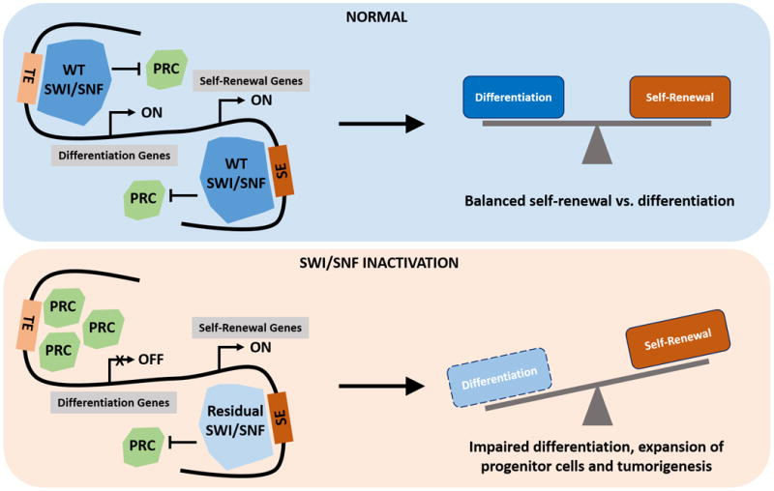
EZH2 inhibitors: Most Studied
SWI/SNF opposes the function of PRC2
SWI/SNF loss → ↑PRC2 activity → ↑H3K27me3 levels
EZH2 is the catalytic subunit of PRC2
EZH2 inhibitors showed preclinical efficacy
FDA approval of tazemetostat in 2020 for epithelioid sarcoma
Phase 2 trial halted – only 2/31 partial responses
Possible synergistic effect with combined histone deacetylase inhibitors?
Lu C and Allis C. Nat Genet. 2017;49(2):178-179.
Chan-Penebre E, et al. Mol Cancer Ther 2017;16(5):850–60.
Wang Y, et al. J Pathol 2017;242(3):371–83.
Wang Y, Mol Cancer Ther. 2018 Dec; 17(12): 2767–2779.
Notes:
I’ll start with EZH2 inhibitors, these have been studied the most in this setting. As mentioned earlier SWI/SNF opposes the function of polycomb repressive complex so when there is inactivation of the SWI/SNF complex there is increase PRC activity and therefore methylation.
EZH2 is the catalytic subunit of PRC2 so the thought is that if you use an EZH2 inhibitor it could help counteract the SWI/SNF loss
Tazemetostat is an ezh2 inhibitor that was approved by the FDA in the US a few years ago, unfortunately a phase 2 trial was halted due to futility as only 2/31 (10 of those were SCCOHT)
People have not given up on EZH2 inhibitors – there is some thought they can be combined with histone deacetylase inhibitors

Slide 55
SWI/SNF and immune checkpoint inhibition (ICI)
Often responsive to ICI despite low TMB, MSS
Predominantly case reports and small series in lung, ovary → endometrium
PD-L1 expression frequent in undifferentiated endometrial cancer (~50%), SCCOHT
Agaimy A. Adv Anat Pathol. 2023;30(3):211-217.
Ono R, et al. Int J Mol Sci. 2019;20(15):3744.
Notes:
The other area where there has been some success is with immune checkpoint inhibition.
You might initially think that it doesn’t make sense that these tumors would be susceptible to immunotherapy as they have low TMB for the most part and are MSS
Most of the data is single case reports which have been extrapolated from the lung and ovary for use in other gyn sites/endometrium
These tumors show frequent PDL1 expression which might help explain why

Slide 56
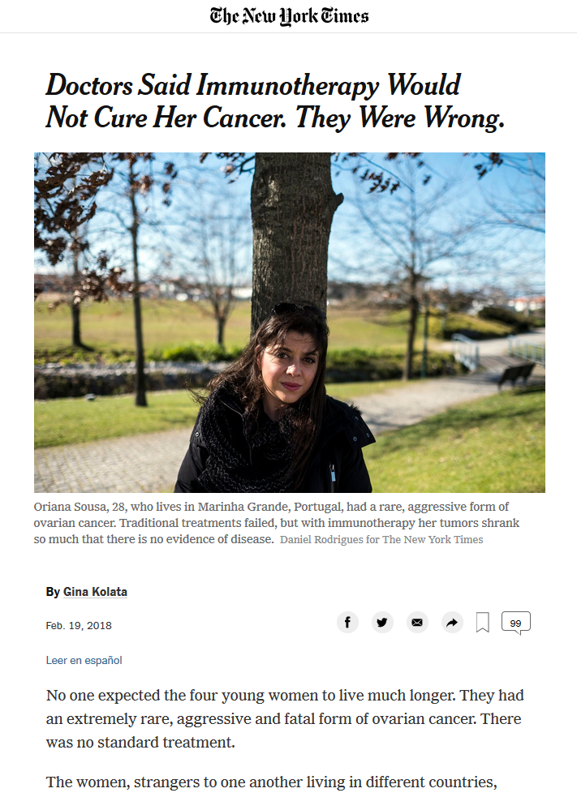
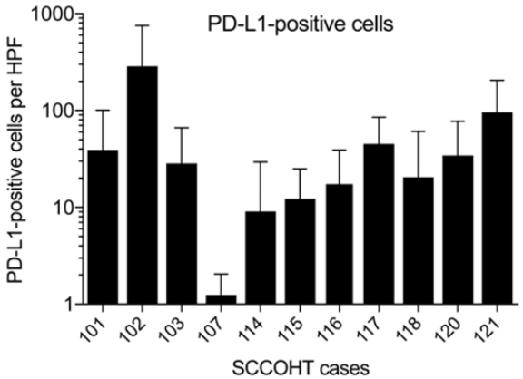
Jelinic P, et al. J. Natl. Cancer Inst. 2018;110:787–790.
Notes:
This was best exemplified by a series of 4 cases published in the JNCI 6 years ago and there was an accompanying article in the NYT that described these 4 young women with SCCOHT who were progressing on traditional chemotherapy. They begged to be on immunotherapy and doctors didn’t want to given the low TMB but they did anyway and 3 of 4 had complete response and one had a durable partial response.

Slide 57
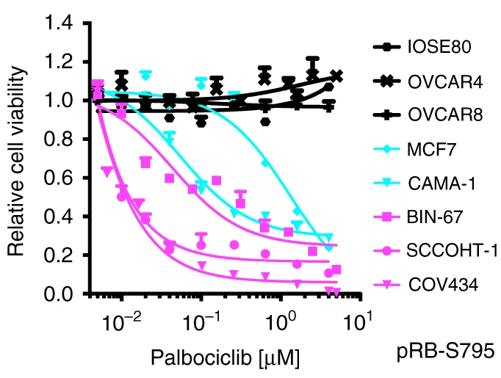
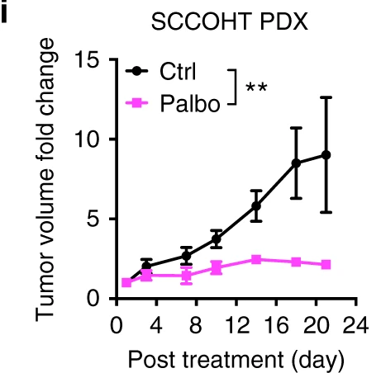
SCCOHT is susceptible to CDK4/6 inhibition
RNAi screens found SCCOHT cells sensitive to CDK4/6 inhibition
SMARCA4-proficient
ovarian cancer
ER+ breast ca
SCCOHT
Xue Y, et al. Nat Commun. 2019; 10: 558.
Notes:
Another thing that has been investigated is CDK4/6 inhibition because RNA interference screen found that cell lines of SCCOHT were very sensitive to inhibition. These drugs already approved for breast cancer so easy to apply.
So if immunotherapy and CDK4/6 are promising why not combine them

Slide 58
If immunotherapy and CDK4/6 inhibitors are promising why not combine?

Slide 59
Combined CDK4/6 and PD-1 Inhibition
21F with small cell carcinoma of the ovary hypercalcemic type
Peritoneal disease and supraclavicular lymph node
Progression through multiple therapies:
  high dose chemo + autologous stem cell transplant
  RT
  Nivolumab (anti PD-1)
  Ipilimumab (anti CTLA-4)
Combined abemaciclib (CDK4/6) and nivolumab therapy → complete response
No evidence of disease at 5 years
Lee EK, et al. JCO Precis Oncol. 2020; 4:736.
Notes:
And that what happened to a patient at DFCI
Disseminated peritoneal disease
She progressed through high dose chemo and SCT, which is currently first line therapy for this disease as well as immunotherapy in isolation
When abemaciclib was added she now has…
Only one case but does show promise of these therapies

Slide 60
Conclusions
SWI/SNF-deficient tumors of the gynecologic tract are rare, aggressive malignancies
Include in differential diagnosis of undifferentiated/rhabdoid tumors of the ovary (endometrium and vulva too)
SWI/SNF immunohistochemistry is very useful for diagnosis, prognosis and potentially predictive purposes
Pre-clinical models and case reports show early promise of targeted therapies
Notes:
Are rare but important to diagnose because they are aggressive
You should think of them when you come across an undifferentiated/rhabdoid tumor of ovary

Slide 61
obrigado(A)!

Slide 62
Thank you!

